Slide 1

Embedded Software Programming
Ambuj Varshney
ambujv@nus.edu.sg
Notes:
++ Thank you for inviting me to give this talk
++ In this talk, I will present a pathway that can enable us to make wireless embedded systems ubiquitous. I will describe my previous research efforts that tackle the critical challenges that limit the growth of wireless embedded systems. These are related to the growing energy asymmetry that exists between sensing, computation and communication blocks on these platforms.
++ Finally, I will conclude my talk by covering the research agenda that I would like to work on as a faculty member.

Slide 2
Course Information
Notes:
++ Over the past few years, I have designed several backscatter and beyond backscatter systems that precisely overcome these critical challenges that have limited the widespread deployment of backscatter on IoT devices.
++ The research vision that I have pursued and would like to pursue as a faculty member is to enable a massive deployment of IoT devices by bridging the energy asymmetry between sensing, computation and communication blocks by designing novel platforms and communication mechanisms. I am going to describe some of my research contributions next.

Slide 3
How would the student’s performance be graded
Component | Weightage to Overall Grade
Project | 50 %
Student Seminar | 20 %
Term Paper | 30 %
The end-term assessment has been removed. No end term assessment.

Slide 4
Course Project
Enables students to learn programming embedded platforms by building an application. The expectation is that students will develop something substantial. It does not necessarily need to have research component
A number of platform available: ESP32, Raspberry Pi, MSP430, Backscatter, FPGAs, and many other. Talk to us! Reach out after lecture or office hours
Component | Weightage to Project
Problem Statement (Novelty) | 25 %
Project Report | 15 %
Presentation | 25 %
Execution | 35%

Slide 5
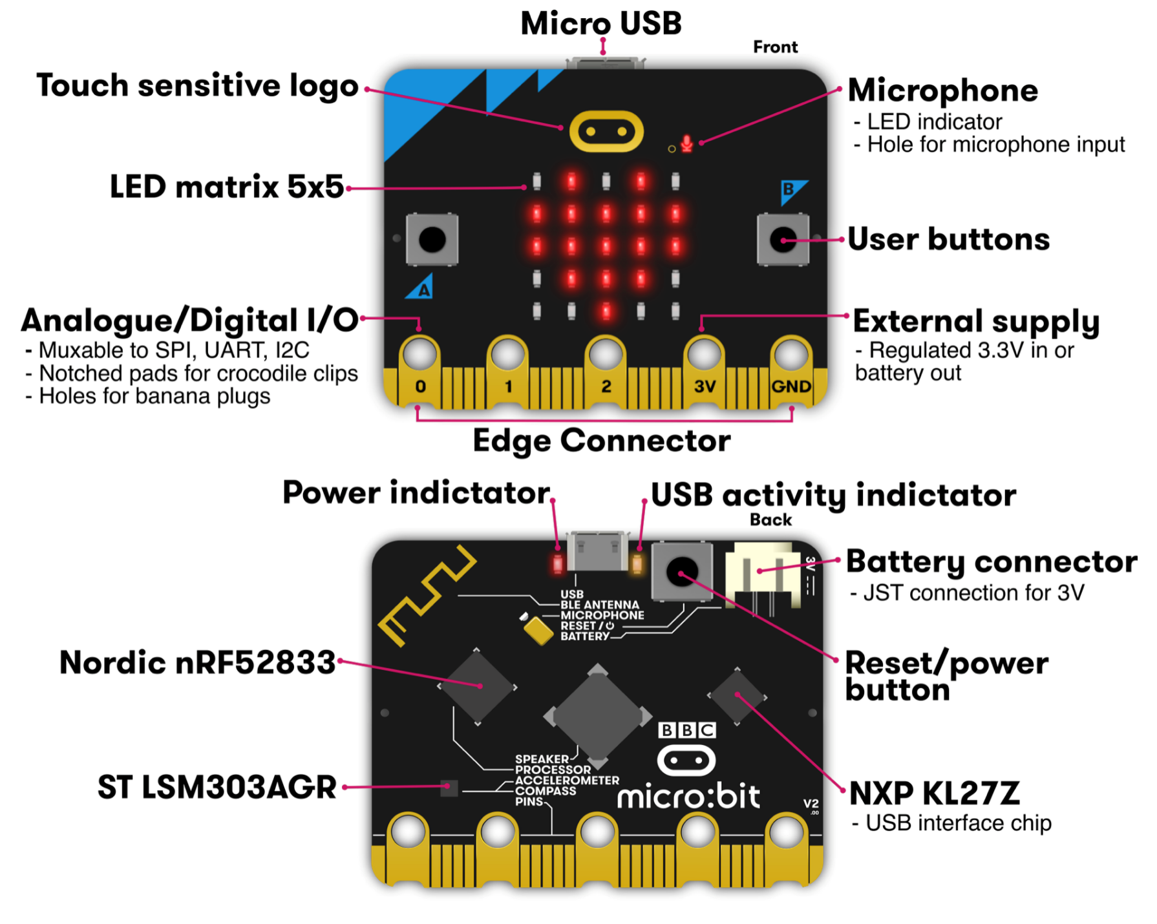
Platforms for Project

Slide 6
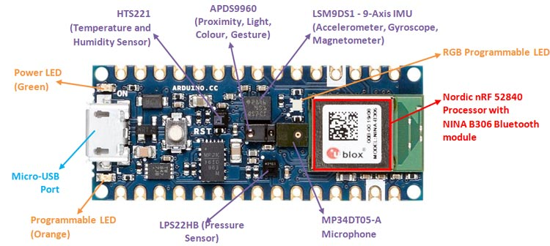
Platforms for project work

Slide 7
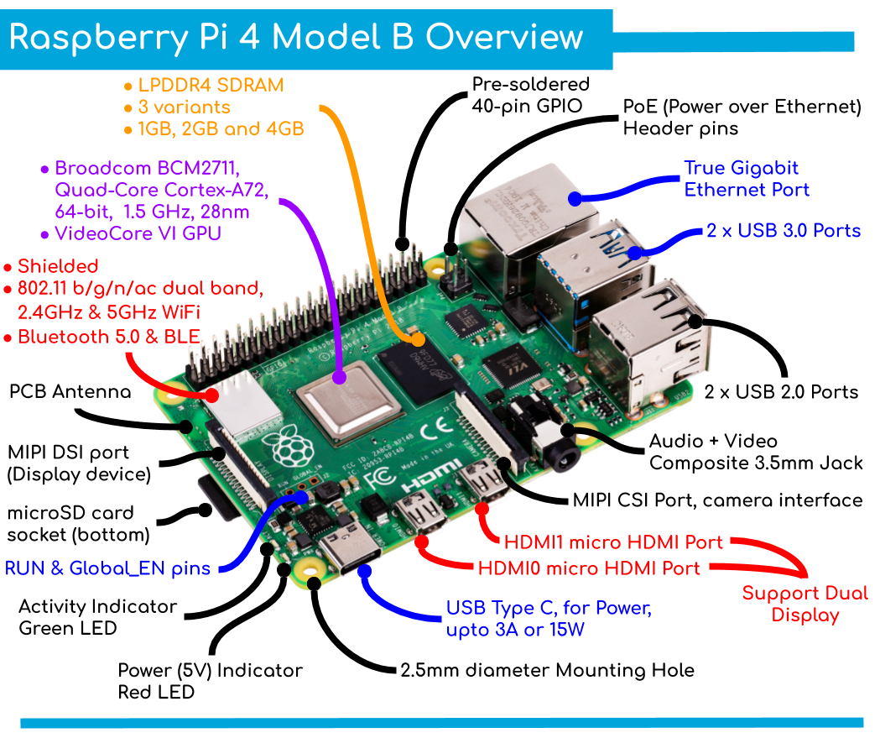
Platform for project work

Slide 8
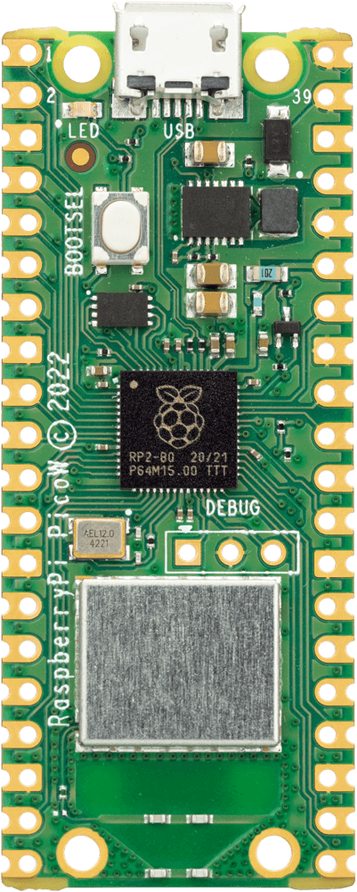
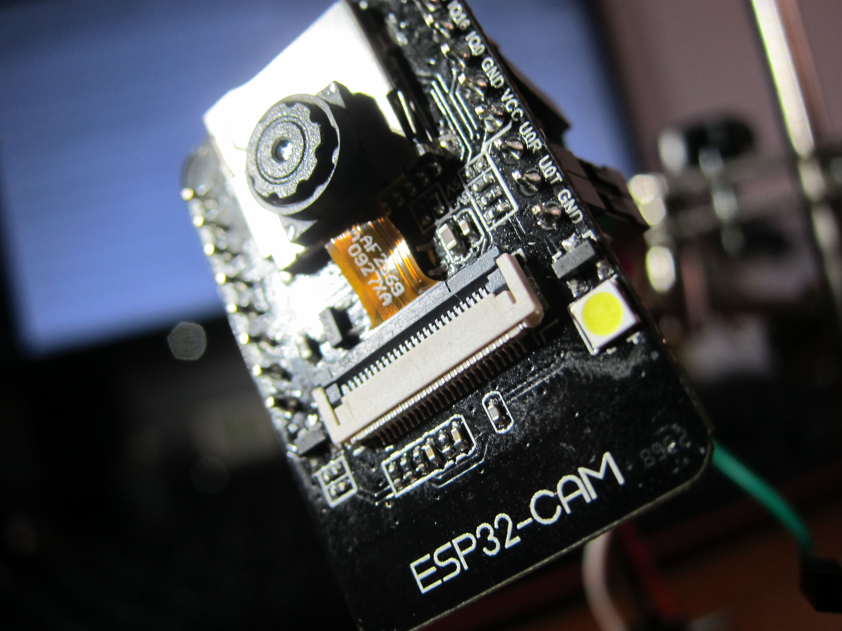
Platform for project work

Slide 9
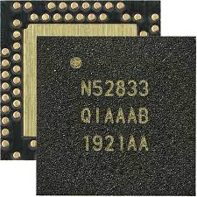
nRF52833 – Microcontroller on the Micro:bit v2
32-bit ARM Cortex-M4F microcontroller
64 MHz core, 128 KB RAM, 512 KB Flash
Floating point support
2.4 GHz Radio: Bluetooth Low energy / 802.15.4
Various peripherals
ADC, PWM
I2C, UART, SPI, USB
RNG, 32-bit Timers, Watchdog, Temperature
Up to 42 I/O pins

Slide 10

Course projects examples – Open AI Whisper and Embedded microphones
Bring high accuracy speech recognition to embedded device?
Too power consume to perform locally
Record audio, transmit to computer (Open AI Whisper), send back translated audio to embedded device;
Latency considerations? Other Optimizations etc?
Notes:
Why do the IoT platforms suffer from this energy challenge? To understand this, we investigate the architecture of the IoT device. We show this architecture in the figure on the slide. It consists of a series of stages that enable us to sense physical phenomena, process and transmit the sensor information through a transceiver such as ZigBee/BLE/LoRa.
This architecture has remained unchanged over the past two decades. We find that during this time, sensors have become exceeding efficient. Today, we find sensors such as an accelerometer or a temperature sensor consumes just a few tens of microwatts of power consumption. However, we find that rest of the architecture components that are shown in red colour remain significantly energy expensive. To understand the reason for this significant energy asymmetry, we look at the following slide.

Slide 11

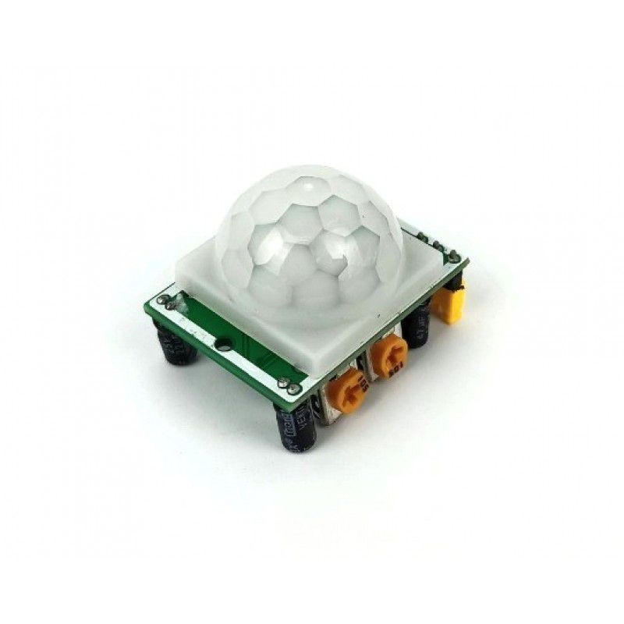
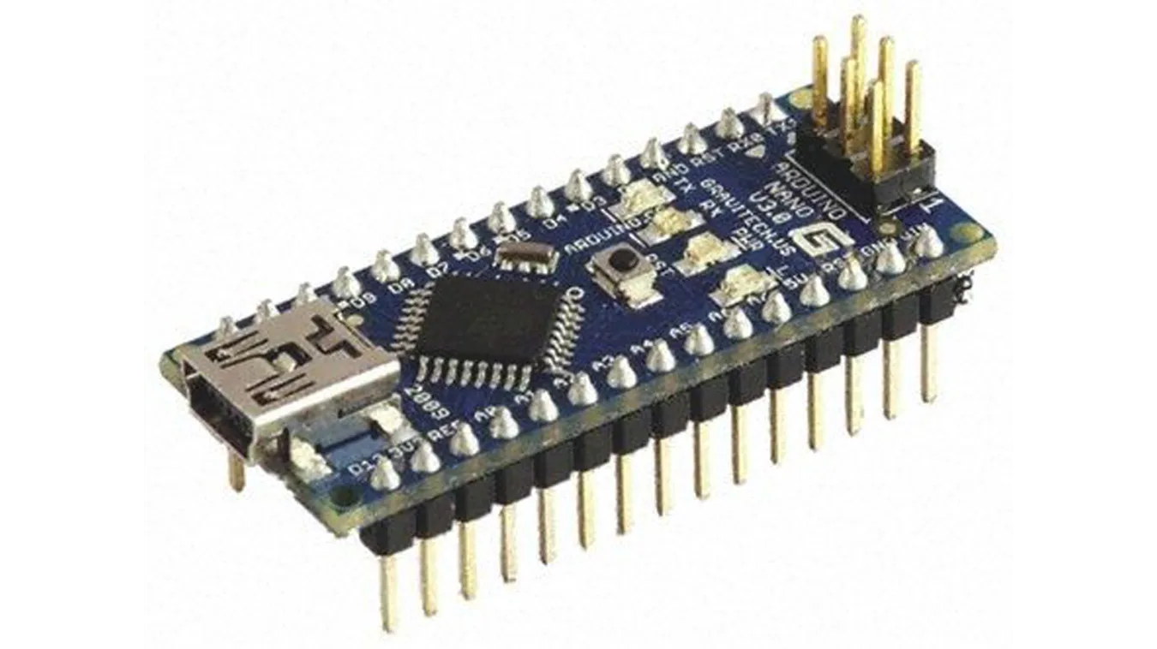
Course projects examples – TinyML and Sensors
Machine learning techniques with sensor data
Tensorflow Lite on Arduino could be used as a platform
Reduce noise? Improve accuracy? Sensor fusion
Notes:
Why do the IoT platforms suffer from this energy challenge? To understand this, we investigate the architecture of the IoT device. We show this architecture in the figure on the slide. It consists of a series of stages that enable us to sense physical phenomena, process and transmit the sensor information through a transceiver such as ZigBee/BLE/LoRa.
This architecture has remained unchanged over the past two decades. We find that during this time, sensors have become exceeding efficient. Today, we find sensors such as an accelerometer or a temperature sensor consumes just a few tens of microwatts of power consumption. However, we find that rest of the architecture components that are shown in red colour remain significantly energy expensive. To understand the reason for this significant energy asymmetry, we look at the following slide.

Slide 12
Course projects examples – Application using IoT platforms, sensors, actuators etc
Something interesting that uses sensor, IoT platforms, actuators
12
Notes:
Why do the IoT platforms suffer from this energy challenge? To understand this, we investigate the architecture of the IoT device. We show this architecture in the figure on the slide. It consists of a series of stages that enable us to sense physical phenomena, process and transmit the sensor information through a transceiver such as ZigBee/BLE/LoRa.
This architecture has remained unchanged over the past two decades. We find that during this time, sensors have become exceeding efficient. Today, we find sensors such as an accelerometer or a temperature sensor consumes just a few tens of microwatts of power consumption. However, we find that rest of the architecture components that are shown in red colour remain significantly energy expensive. To understand the reason for this significant energy asymmetry, we look at the following slide.

Slide 13
Important Deadlines
Event | Date
Lectures | Starting Week 1 (15th January)
Student seminar paper selection | End of recess week (10th March)
Finalising project statement | End of recess week (10th March)
Student seminars | Lectures from 18th March
Project presentation | 15th April 2024
Term paper submission | 19th April 2024
Project submission | 19th April 2024

Slide 14
Roadmap of the lecture today
Let us recall what was covered in the last lecture
Sensors and actuators
Teardown of common devices
Interfacing actuators through DAC and PWM
Interfacing peripherals through busses, UART
Introduction to SPI
Notes:
Here is the roadmap of the major topics that I am going to cover during the presentation. We have already covered the exponential growth of the internet of things; next, I will talk about the critical energy challenge that can severely hinder this massive growth and preventing us from realising this immense economic value enabled by the IoT.

Slide 15
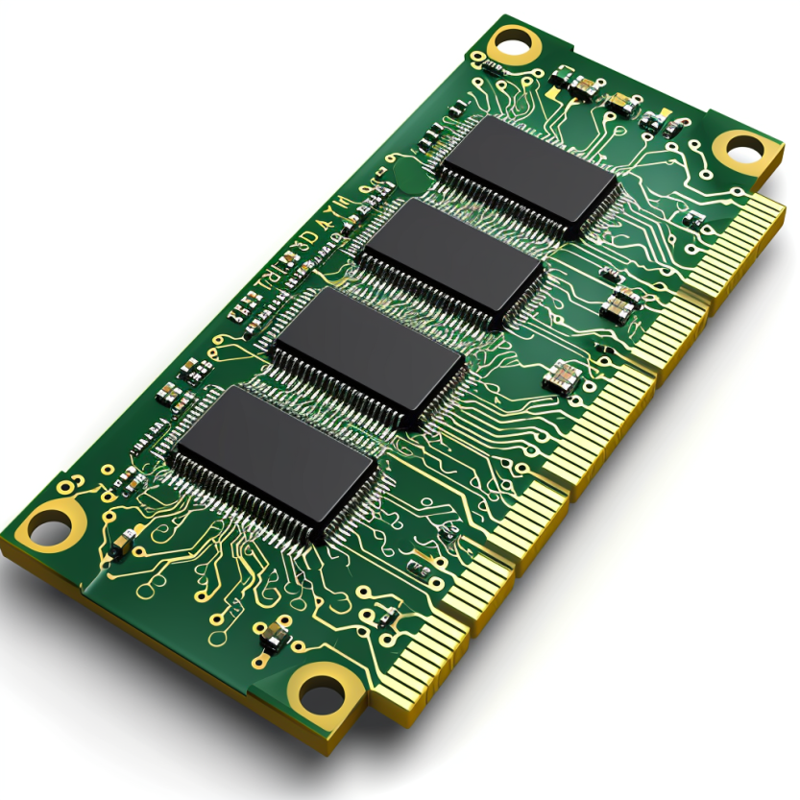
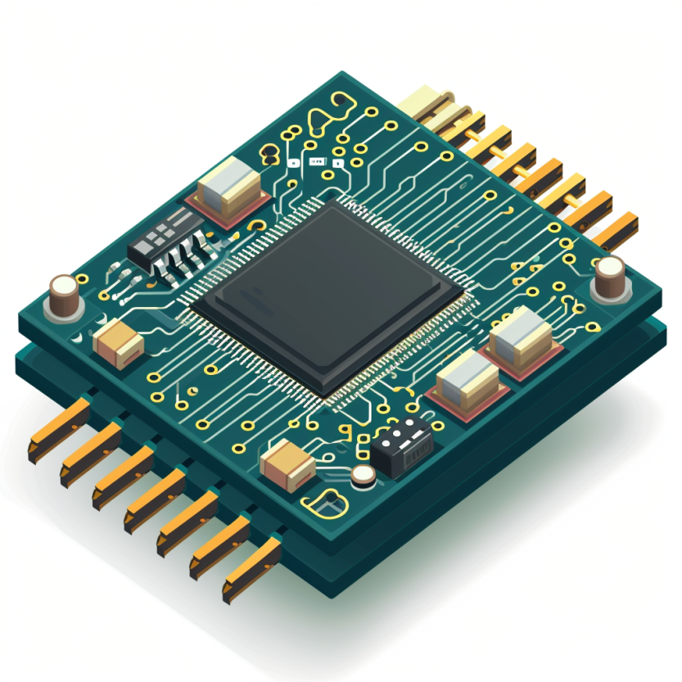

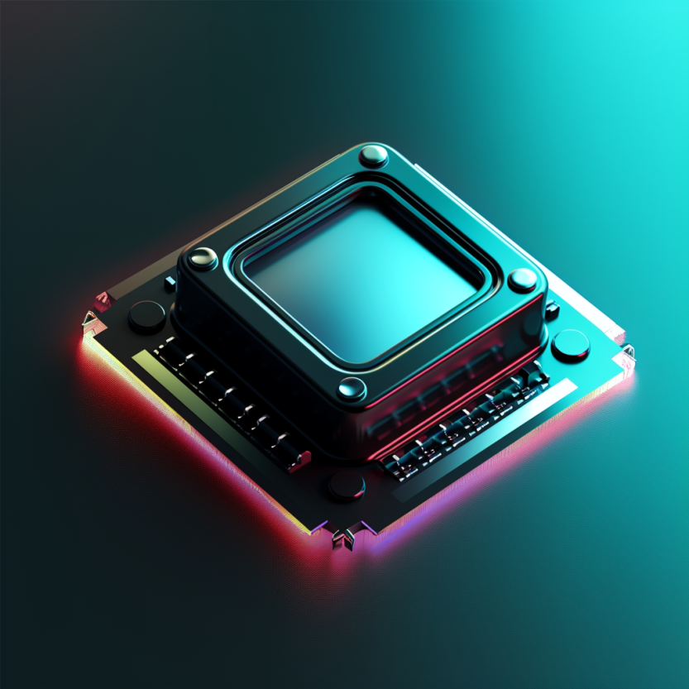


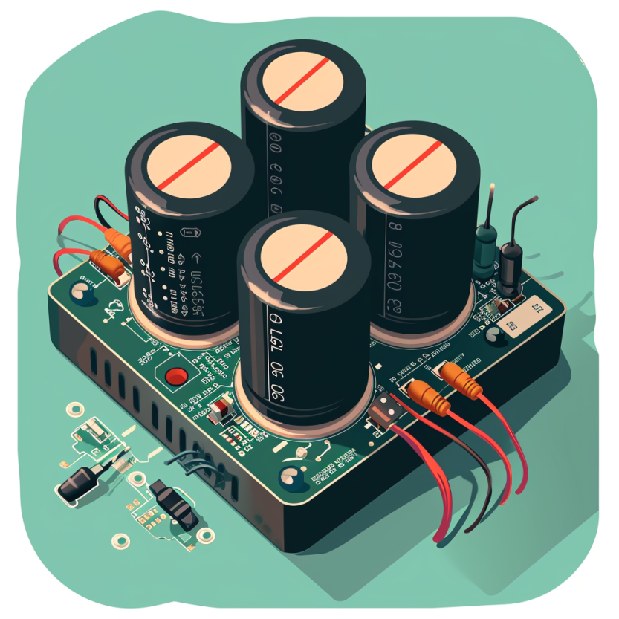
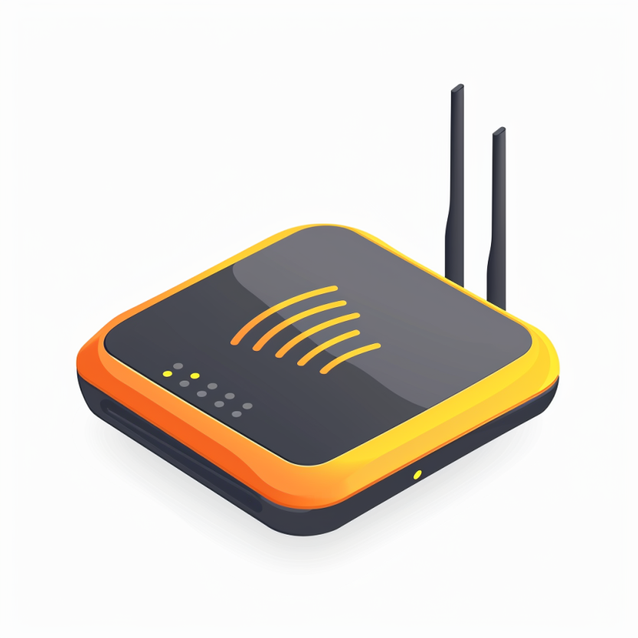

Four main tasks performed by an embedded device
Computation and Storage
Sensing and Actuation
Power
Management
Wireless Networking
Notes:
First, we look at the computational elements, and these consist of a microcontroller or an FPGA. Today, we find that these computational elements consume at least one order of magnitude higher power consumption when compared to the commonly used sensors.
However, we also find that microcontrollers are increasingly becoming energy efficient. We investigate a typical microcontroller that has been used in sensor platforms over the past two decades. We find that energy efficiency has improved by almost two orders of magnitude. Some of the present-generation microcontrollers, such as Ambiq Apollo4 consume just 3 uA/MHz than 330 uA for MSP430 used on platforms such as TelOS B.
If the trend continues, we can expect the microcontrollers to catch up with the sensors and become energy-efficient. This significant improvement is that the digital components are increasing becoming efficient as they follow moore’s law.

Slide 16
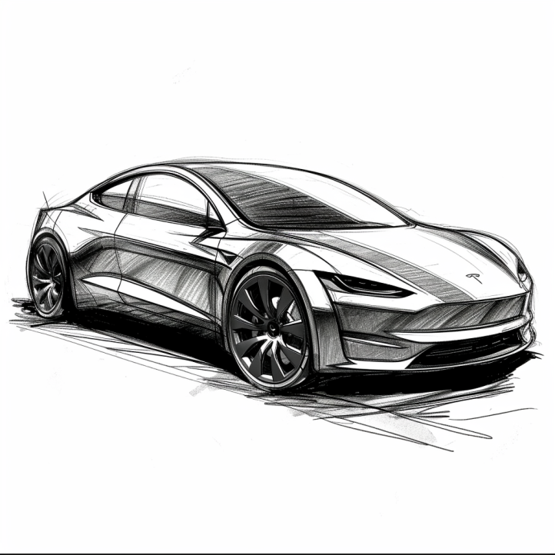
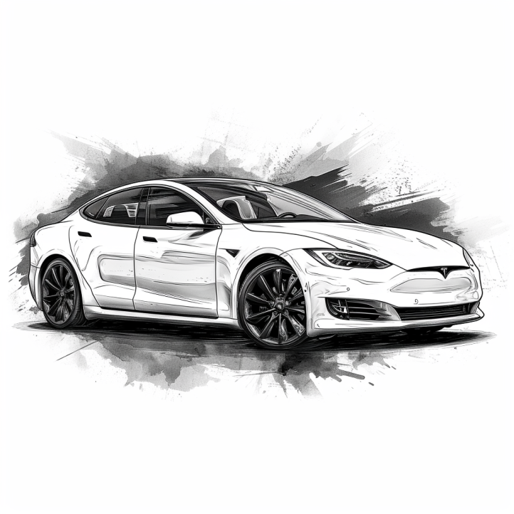
Cars are all software and sensors
Electric cars have numerous sensors and microcontrollers
Various sensors that are used in cars include:
Tracking location: GPS (global positioning system)
Distance measurement: Ultrasonic sensors
Terrain mapping: Lidar (light detection and ranging)
Proximity sensing: radar
Various forms of cameras
Motion sensor: accelerometers
…. And many more
Notes:
First, we look at the computational elements, and these consist of a microcontroller or an FPGA. Today, we find that these computational elements consume at least one order of magnitude higher power consumption when compared to the commonly used sensors.
However, we also find that microcontrollers are increasingly becoming energy efficient. We investigate a typical microcontroller that has been used in sensor platforms over the past two decades. We find that energy efficiency has improved by almost two orders of magnitude. Some of the present-generation microcontrollers, such as Ambiq Apollo4 consume just 3 uA/MHz than 330 uA for MSP430 used on platforms such as TelOS B.
If the trend continues, we can expect the microcontrollers to catch up with the sensors and become energy-efficient. This significant improvement is that the digital components are increasing becoming efficient as they follow moore’s law.

Slide 17
So, what are sensors ?
They are an eyes and ears for an embedded device. They sense environment and help to understand the physical world. Sensor is an electronic component that measures a physical phenomenon.
What are the phenomenon that you would like to sense and measure?
Temperature
Humidity
Acoustic
Vital signs
…….
Choice of sensor depends on the target embedded application
Notes:
First, we look at the computational elements, and these consist of a microcontroller or an FPGA. Today, we find that these computational elements consume at least one order of magnitude higher power consumption when compared to the commonly used sensors.
However, we also find that microcontrollers are increasingly becoming energy efficient. We investigate a typical microcontroller that has been used in sensor platforms over the past two decades. We find that energy efficiency has improved by almost two orders of magnitude. Some of the present-generation microcontrollers, such as Ambiq Apollo4 consume just 3 uA/MHz than 330 uA for MSP430 used on platforms such as TelOS B.
If the trend continues, we can expect the microcontrollers to catch up with the sensors and become energy-efficient. This significant improvement is that the digital components are increasing becoming efficient as they follow moore’s law.

Slide 18
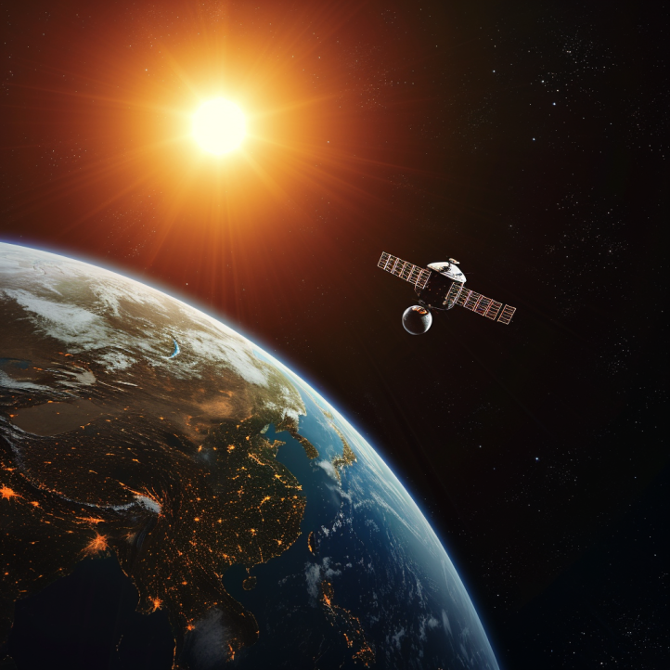
Different forms of sensing: Active vs Passive
Passive Sensing
Active Sensing
When we talk about embedded systems we focus on passive sensing. As It is much cheaper and at a lower energy consumption

Slide 19
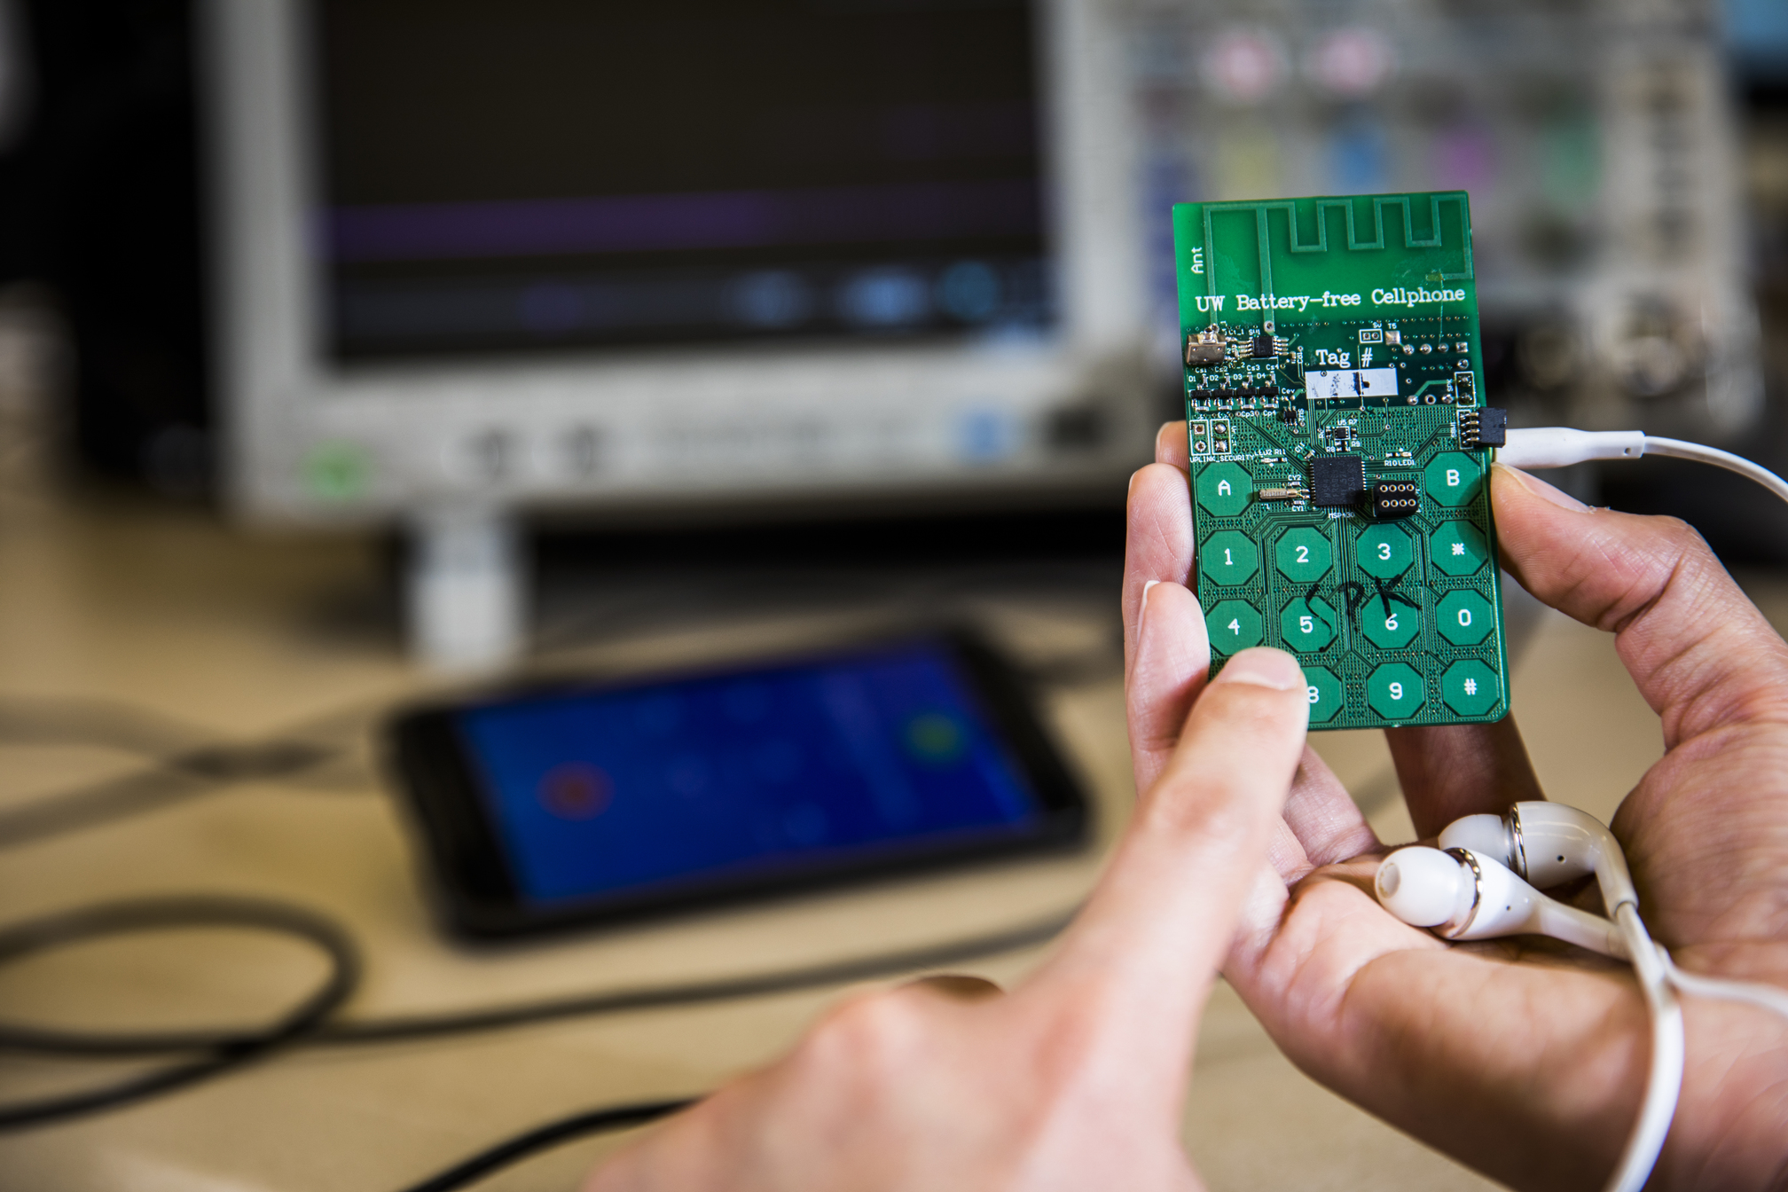
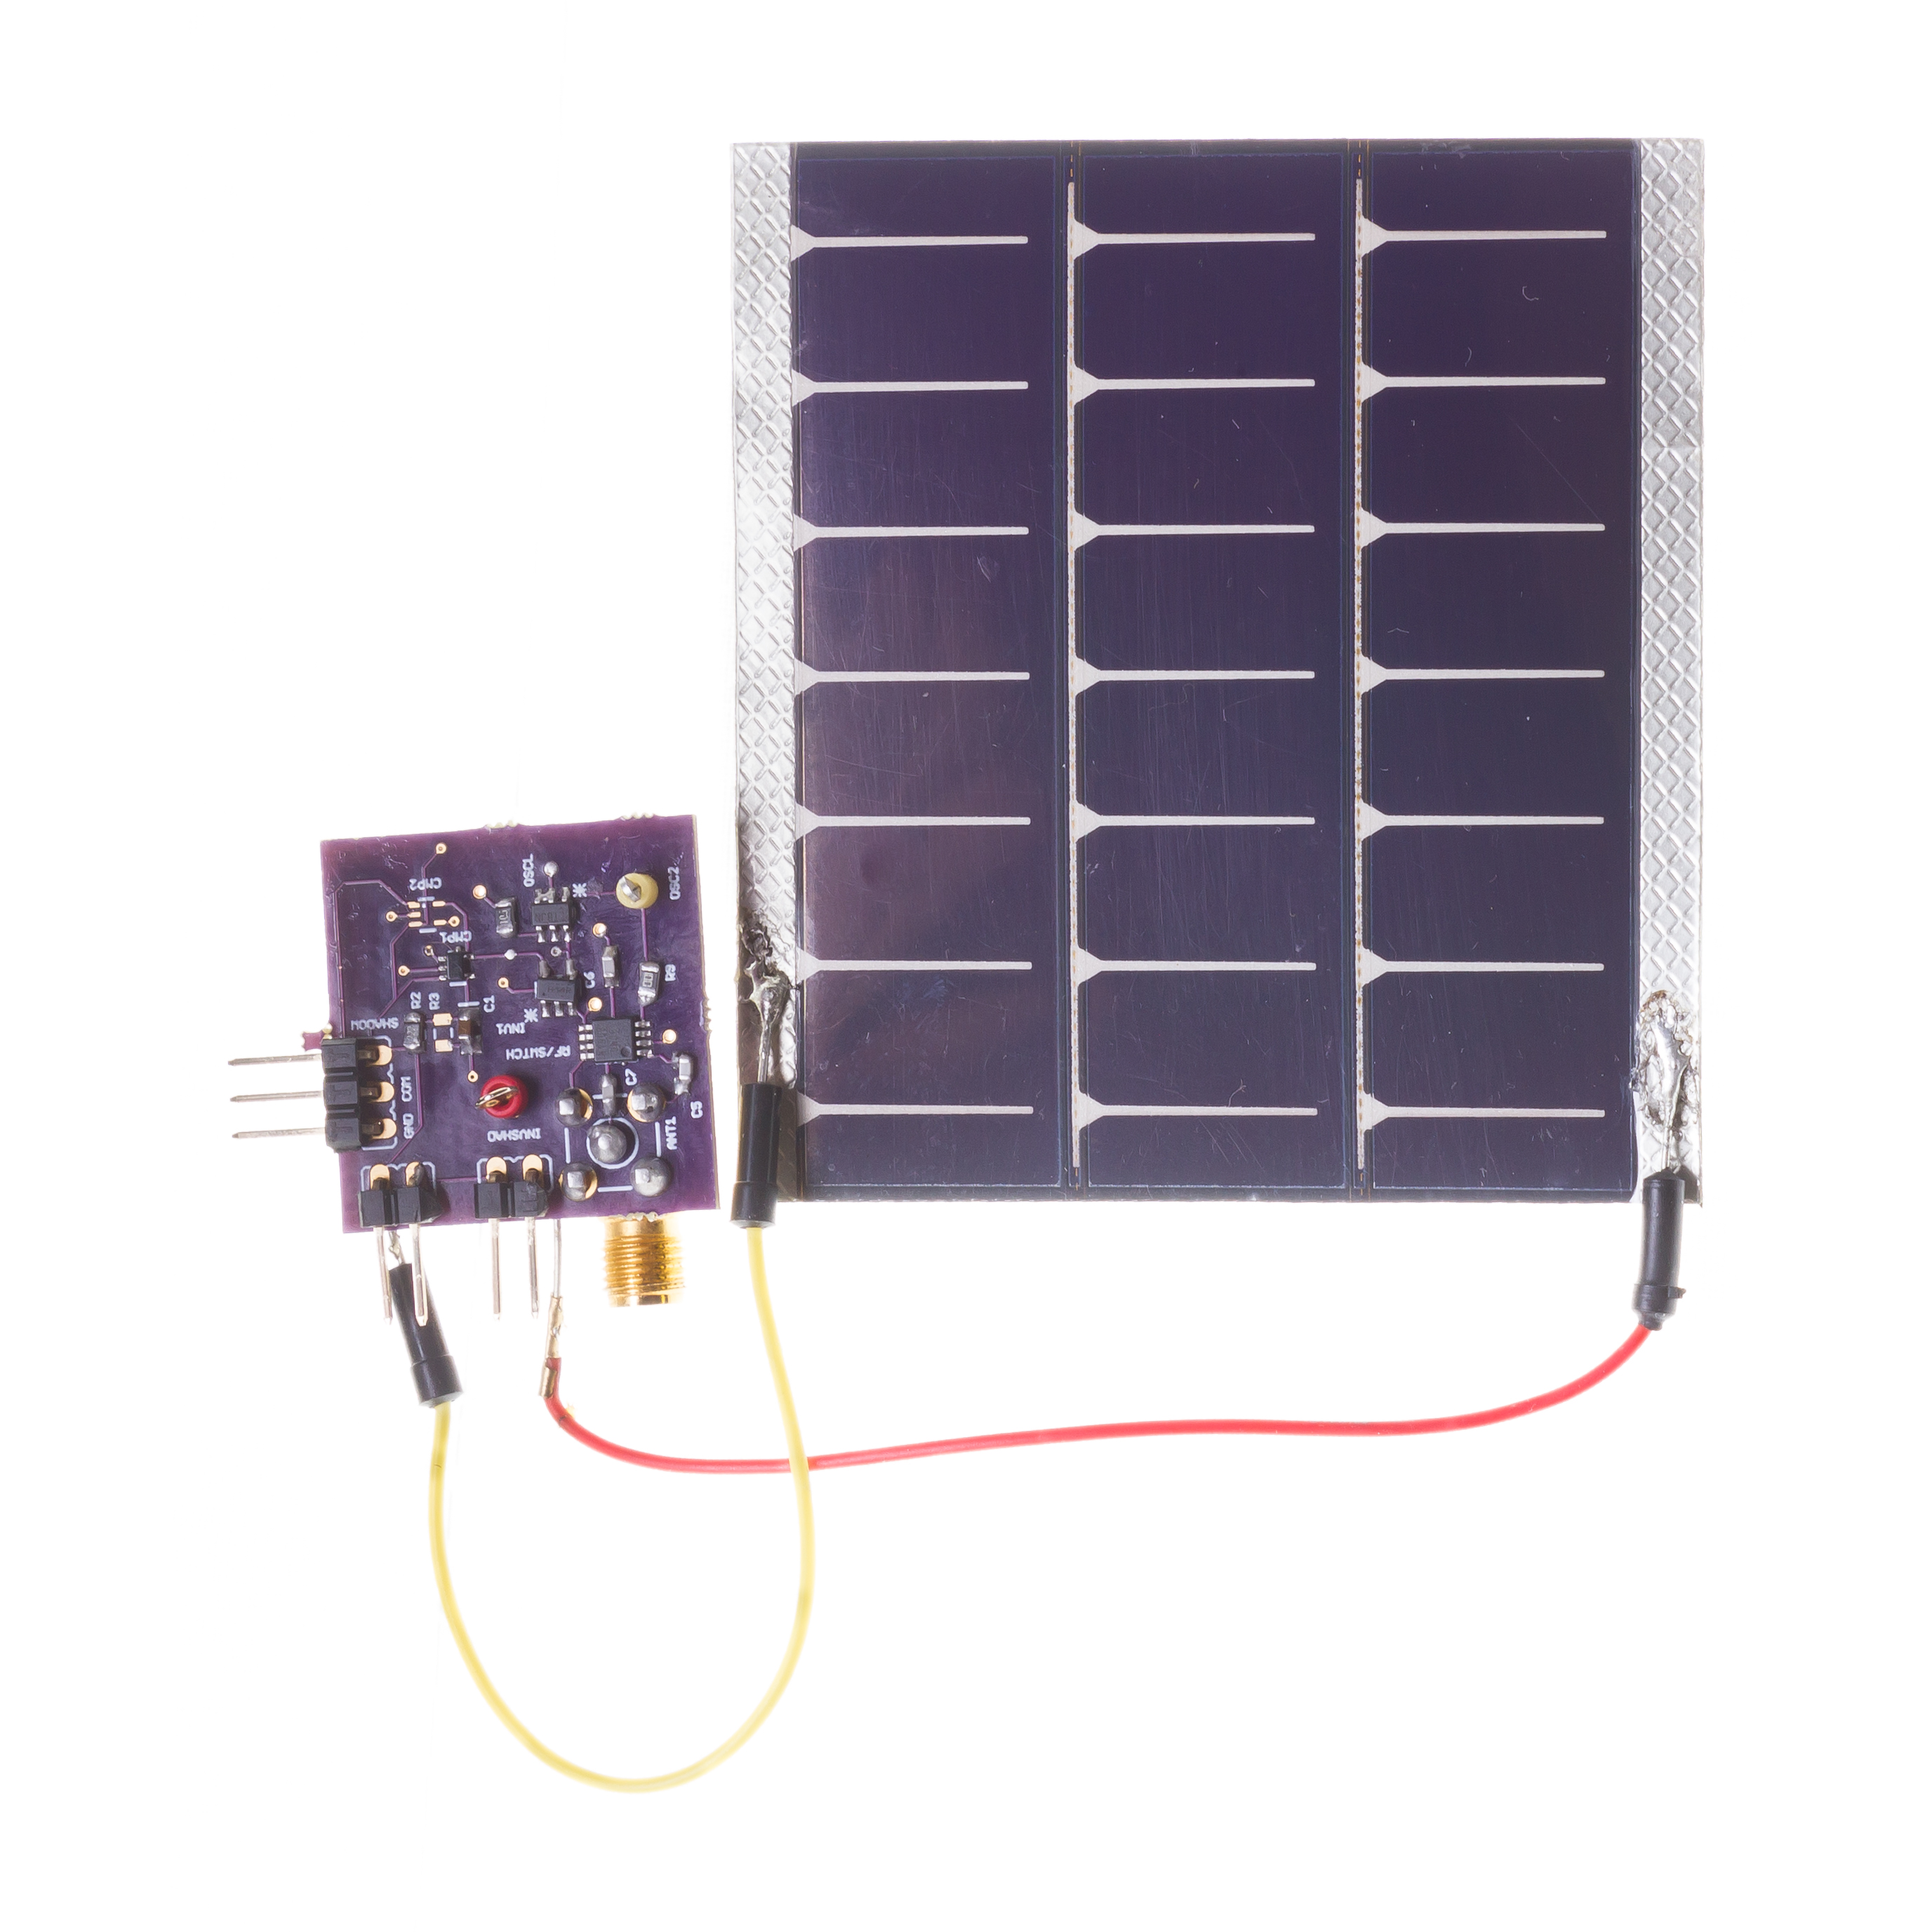
Sensors have become exceedingly energy-efficient
During past decades, sensors have become exceedingly energy-efficient
E.g., Accelerometer, Temperature, Image Sensors: Few µW’s of power
Mostly passive sensors in constrained wireless embedded devices

Slide 20
Sensors transform phenomenon into electrical signals
How sensors convert physical phenomena into electrical signals, we refer to Ohm's Law, which states that Voltage (V) equals Current (I) times Resistance (R)
V (Voltage) = I (Current) X R (Resistance)
By altering one of the variables in Ohm’s law —Voltage (V), Current (I), or Resistance (R)—in response to changes in the phenomenon, a sensor generates an analog electrical signal that corresponds to that phenomenon.

Slide 21
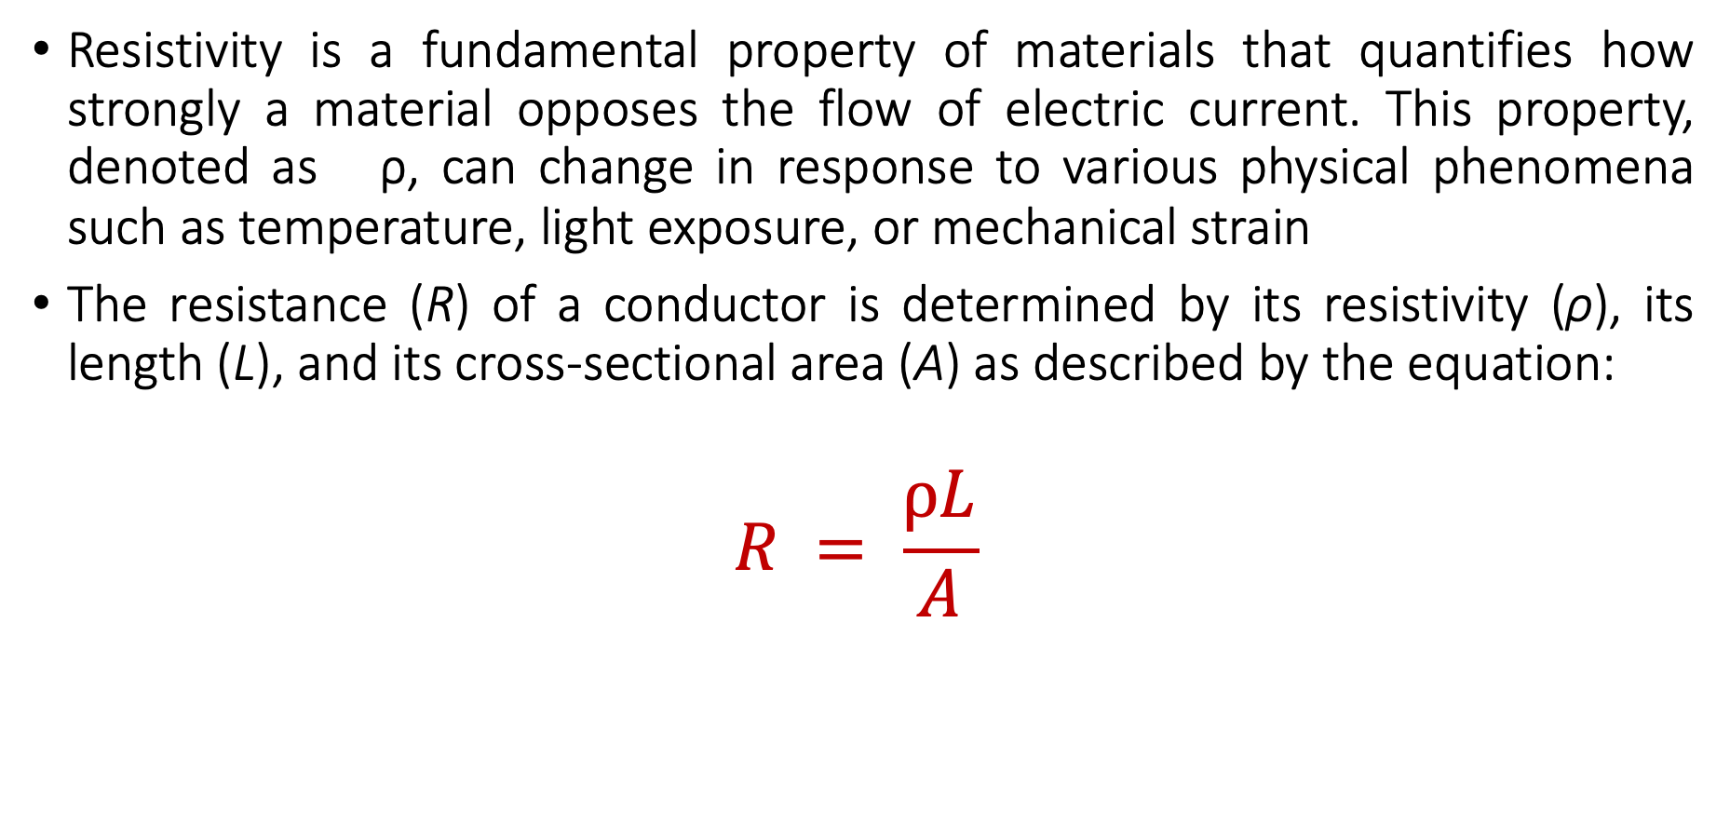
Material Resistivity and its Role in Sensing Phenomena
Resistivity is a fundamental property of materials that quantifies how strongly a material opposes the flow of electric current. This property, denoted as ρ, can change in response to various physical phenomena such as temperature, light exposure, or mechanical strain
The resistance (R) of a conductor is determined by its resistivity (ρ), its length (L), and its cross-sectional area (A) as described by the equation:
$$R = \frac{ρL}{A}$$

Slide 22
Material Resistivity and its Role in Sensing Phenomena
Resistivity (ρ): Materials with higher resistivity create more resistance for the same length and area. Resistivity is sensitive to physical conditions;
Temperature: Many conductors have higher resistivity at higher temperatures.
Light: Some materials (like photoresistors) change their resistivity exposed to light.
Strain: Materials known as strain gauges increase in resistivity when stretched.

Slide 23
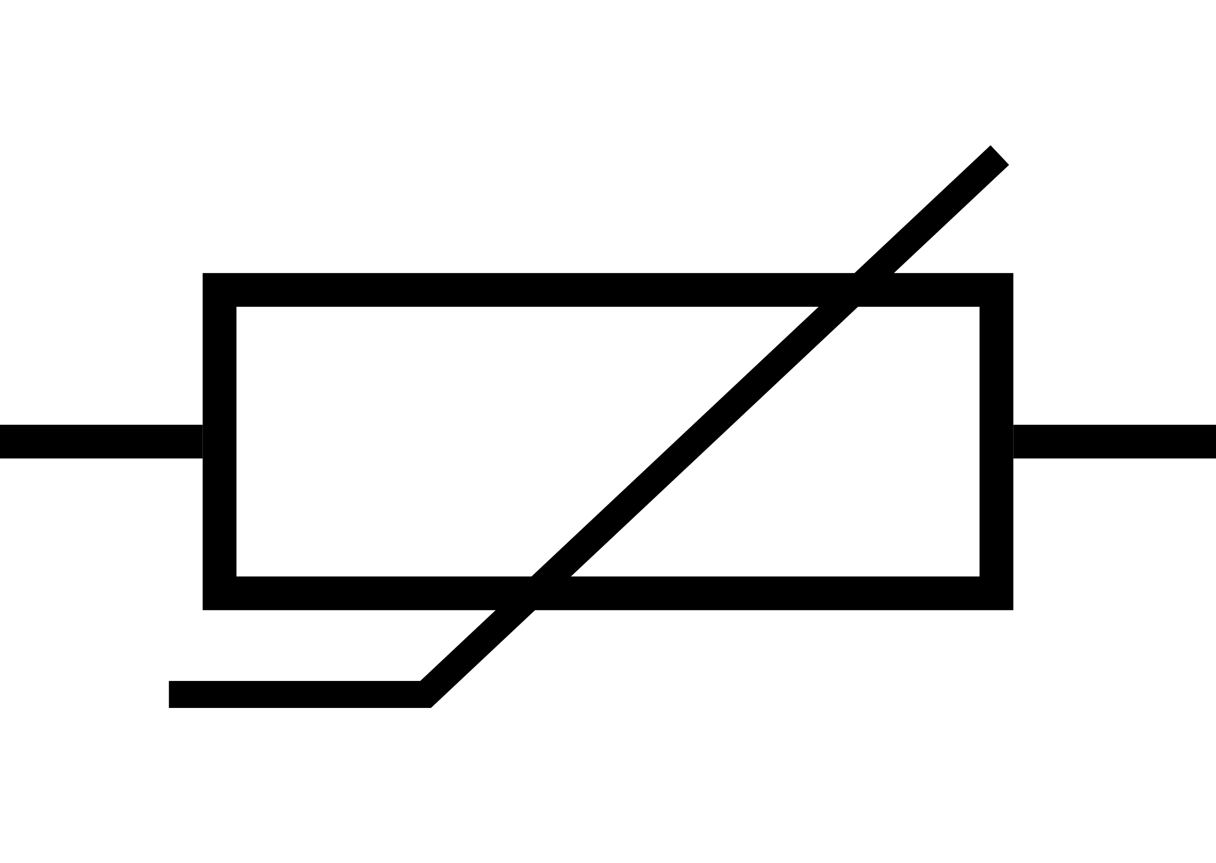
Temperature sensing using resistivity changes
Thermistor is a sensor which varies in resistance based on temperature
Advantages: They are cheap and easy to use. Low cost
Disadvantages: They have a non-linear transfer function

Slide 24
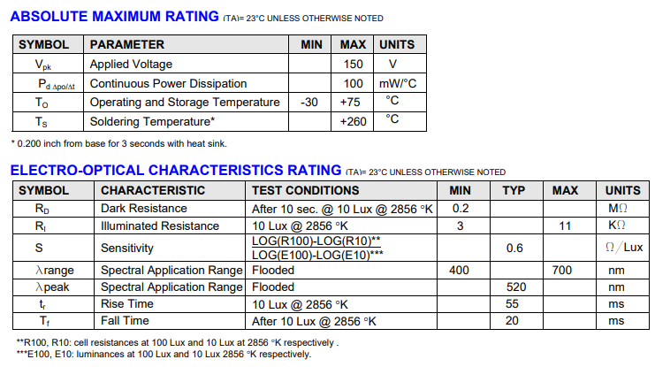
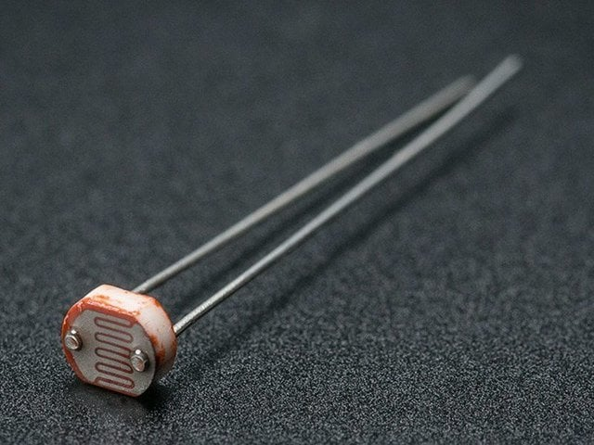
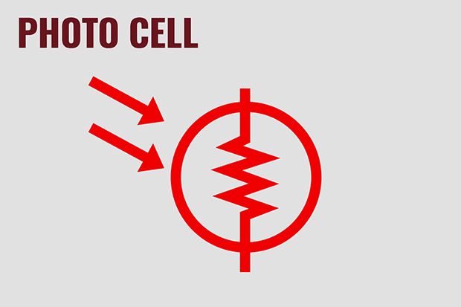
Light sensing using resistive changes
Photocell changes resistance with light (non-linear)
Example:
10 kΩ when dark
1 kΩ when light

Slide 25
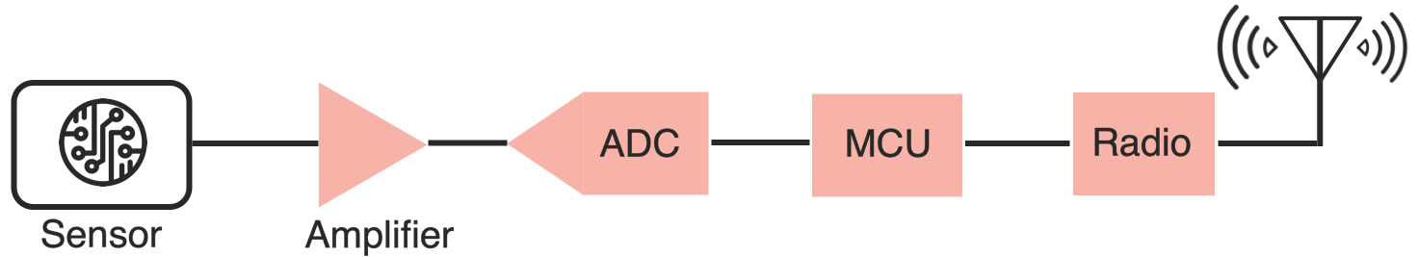
Taking a step back: Microcontrollers are digital
Up to this point, we have talked about translating physical phenomenon to analog electrical signal changes
How do we convert the analog signal into digital?
Do we need to do any processing before the conversion operation?
Conventional and widely used architecture of embedded wireless platform
Notes:
Why do the IoT platforms suffer from this energy challenge? To understand this, we investigate the architecture of the IoT device. We show this architecture in the figure on the slide. It consists of a series of stages that enable us to sense physical phenomena, process and transmit the sensor information through a transceiver such as ZigBee/BLE/LoRa.
This architecture has remained unchanged over the past two decades. We find that during this time, sensors have become exceeding efficient. Today, we find sensors such as an accelerometer or a temperature sensor consumes just a few tens of microwatts of power consumption. However, we find that rest of the architecture components that are shown in red colour remain significantly energy expensive. To understand the reason for this significant energy asymmetry, we look at the following slide.

Slide 26
ADC: Bridging the analog and digital worlds
ADCs convert analog signals, which have a continuous range of values, into digital signals, which have discrete numerical representations. This is essential for digital devices to process real-world analog inputs
What are the various parameters of the ADC?
Resolution: Determined by the number of bits the ADC uses to represent the analog value. More bits mean higher resolution and finer granularity in the output
Sampling Rate: The frequency at which the ADC samples the analog signal. Higher sampling rates can capture more detail and are necessary to comply with the Nyquist theorem. It also means higher power consumption
Accuracy: The closeness of the ADC's output to the true input value. It includes factors such as linearity, noise, and error rate
Notes:
Why do the IoT platforms suffer from this energy challenge? To understand this, we investigate the architecture of the IoT device. We show this architecture in the figure on the slide. It consists of a series of stages that enable us to sense physical phenomena, process and transmit the sensor information through a transceiver such as ZigBee/BLE/LoRa.
This architecture has remained unchanged over the past two decades. We find that during this time, sensors have become exceeding efficient. Today, we find sensors such as an accelerometer or a temperature sensor consumes just a few tens of microwatts of power consumption. However, we find that rest of the architecture components that are shown in red colour remain significantly energy expensive. To understand the reason for this significant energy asymmetry, we look at the following slide.

Slide 27
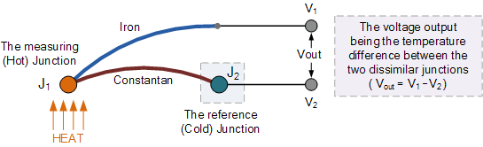
Beyond resistive changes sensing: Potential
Thermocouple generates a voltage based on temperature
This principal is also used to enable harvesting energy from heat energy

Slide 28
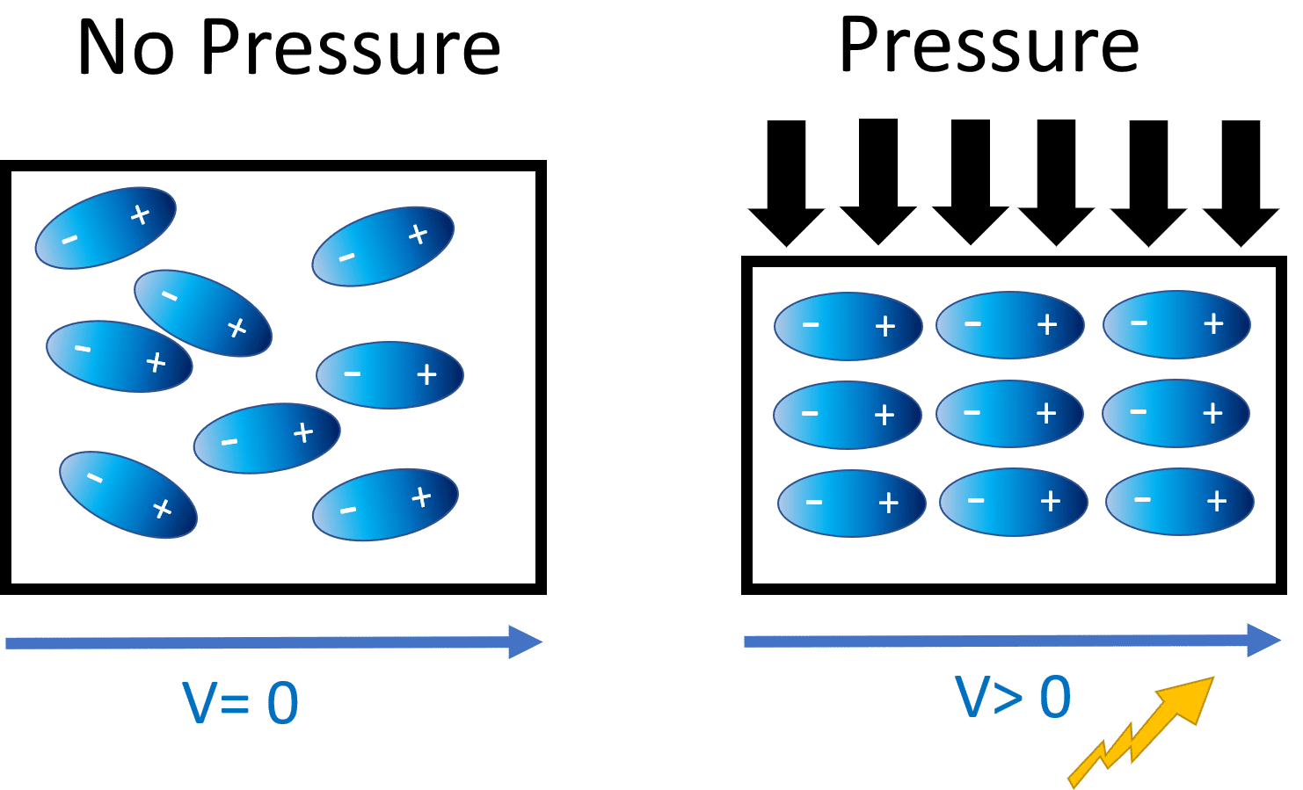
Generating voltage via piezoelectric effect
Compression of the material generates a voltage
Various sources of compression:
Air Pressure
Acceleration
Strain

Slide 29
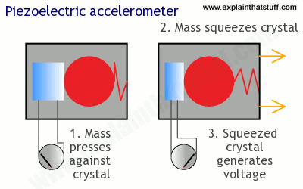
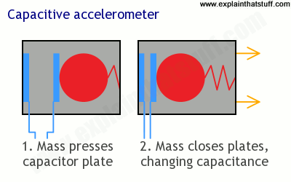
Beyond resistive changes sensing: Potential
Generate a change in voltage that changes based on force

Slide 30
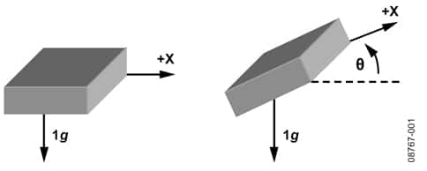
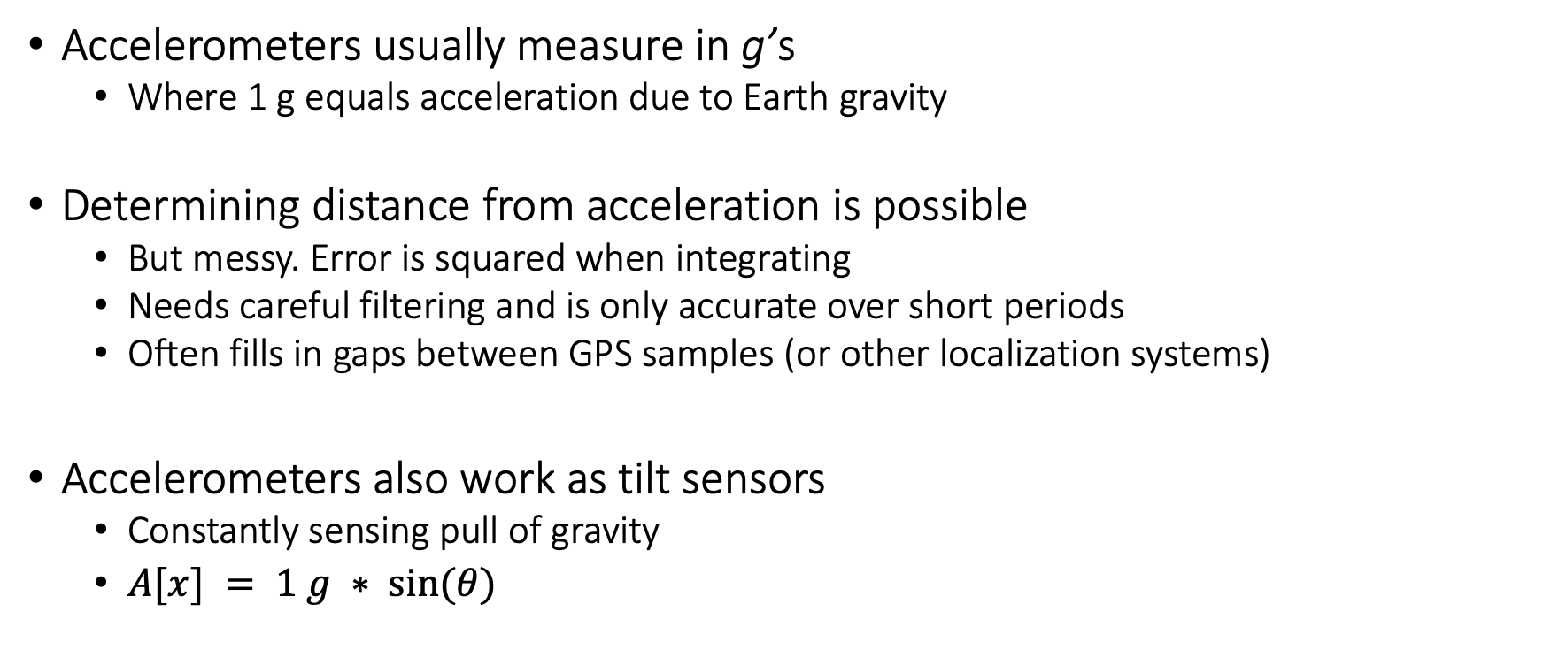
Motion sensing: accelerometers
Accelerometers usually measure in g’s
Where 1 g equals acceleration due to Earth gravity
Determining distance from acceleration is possible
But messy. Error is squared when integrating
Needs careful filtering and is only accurate over short periods
Often fills in gaps between GPS samples (or other localization systems)
Accelerometers also work as tilt sensors
Constantly sensing pull of gravity
$A[x] = 1 g ∗ sin⁡(θ)$

Slide 31
Motion sensing: Inertial measurement unit (IMU)
IMUs (a.k.a 9 degree-of-freedom, 9DOF) track motion of a device
Acceleration (X, Y, Z axes)
Rotation (X, Y, Z axes)
Magnetism (X, Y, Z axes)
Sometimes 6DOF with Acceleration + one of the others
Intelligent sensing: combines multiple sensors, ADCs, and computation with a wired interface
9 analog inputs would otherwise be too many
Can be used to track motion, determine transportation method
Smartphones, Robotics, etc.

Slide 32
Roadmap of the lecture today
Let us recall what was covered in the last lecture
Sensors and actuators
Teardown of common devices
Interfacing actuators through DAC and PWM
Interfacing peripherals through busses, UART
Introduction to SPI
Notes:
Here is the roadmap of the major topics that I am going to cover during the presentation. We have already covered the exponential growth of the internet of things; next, I will talk about the critical energy challenge that can severely hinder this massive growth and preventing us from realising this immense economic value enabled by the IoT.

Slide 33
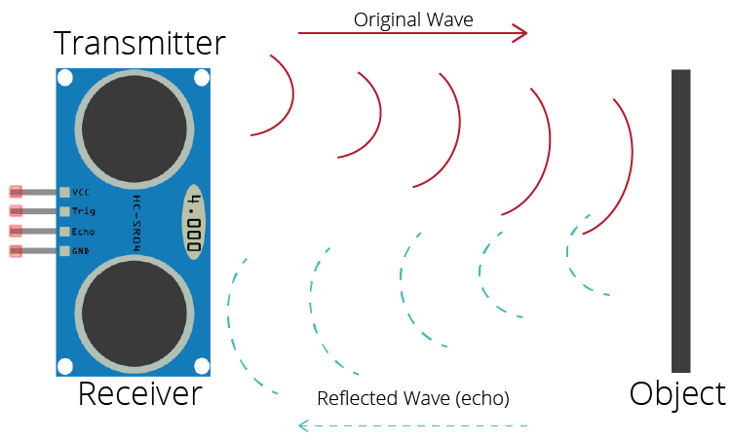
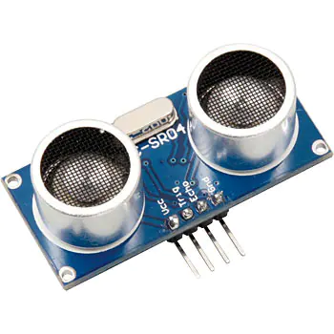
Active sensing: Ultrasound sensor
Emits high frequency sound waves from sensor which bounces from objects that are present in the environment
Estimates distance, proximity by measuring time taken for sounds waves to bounce back and propagate back to the ultrasound device
Power consuming, though can be used on IoT devices
Common application: Robotics, obstacle detection, water level sensing

Slide 34
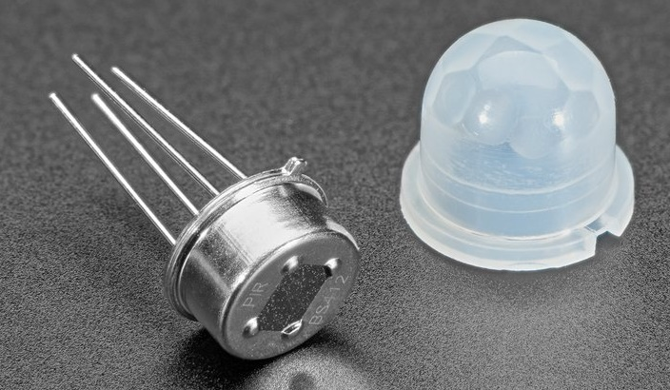
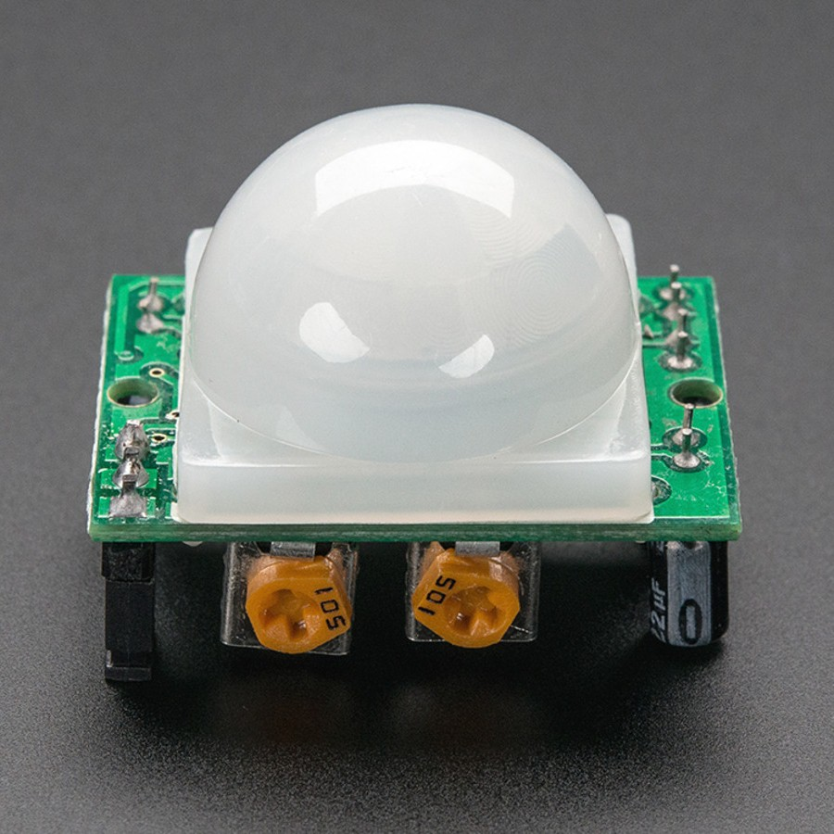
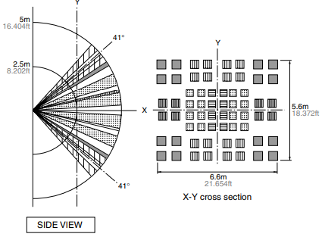
Passive Infrared (PIR) sensor
Detect movement in the environment
By detecting change in IR levels
Often come with plastic lens cover to improve field of view and range

Slide 35
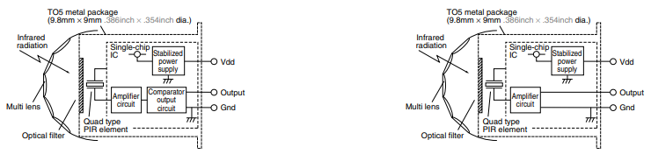
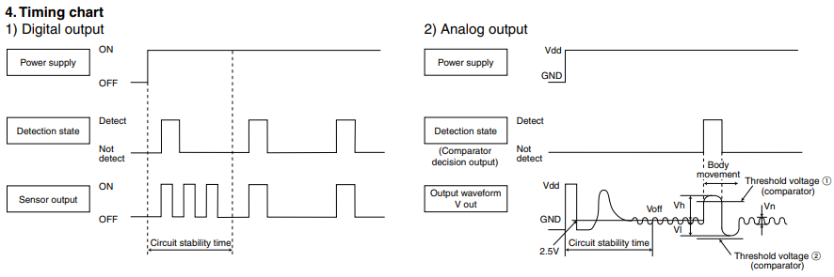
PIR sensors come in digital and analog forms
Digital includes a preconfigured comparator

Slide 36
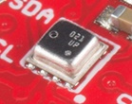
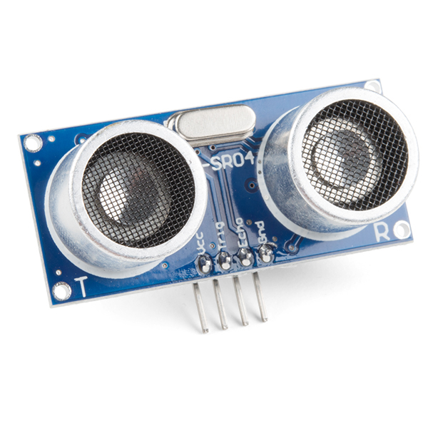
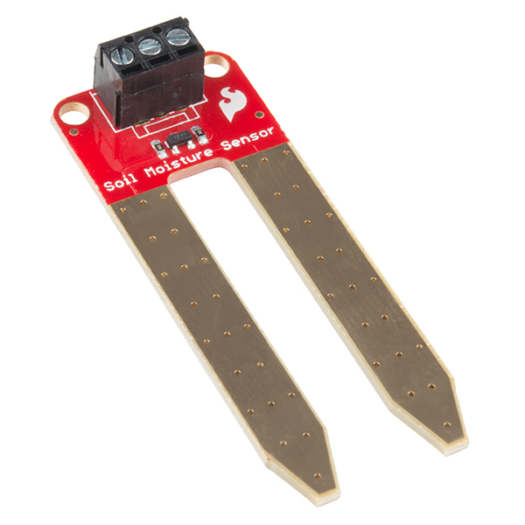
There are even more types of sensors
Environment: Pressure, Humidity, Air Velocity, Air Quality
Rotation: Gyroscope
Distance: Ultrasonic, Lidar, or Radar
Biometric: Pulse Oximeter, Heart Rate
Agricultural: Soil moisture

Slide 37
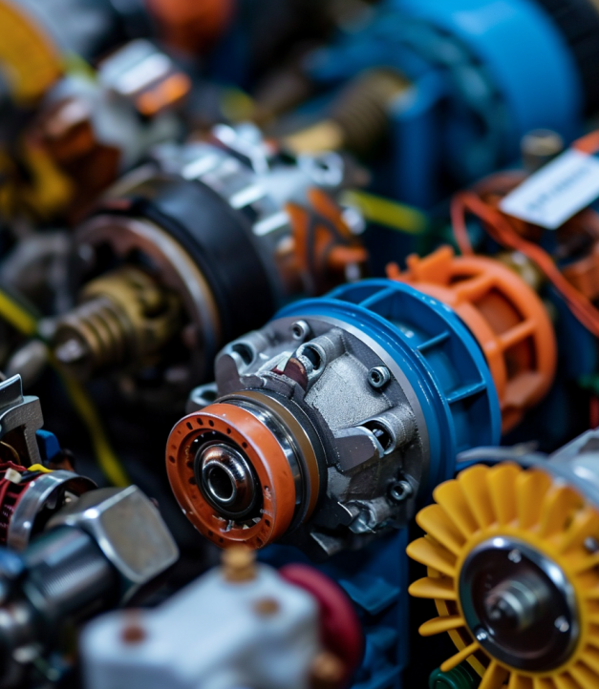
What are actuators?
Actuator is an electronic component that modifies a physical quantity
Light/LED
Motor
Speaker
…….
Notes:
First, we look at the computational elements, and these consist of a microcontroller or an FPGA. Today, we find that these computational elements consume at least one order of magnitude higher power consumption when compared to the commonly used sensors.
However, we also find that microcontrollers are increasingly becoming energy efficient. We investigate a typical microcontroller that has been used in sensor platforms over the past two decades. We find that energy efficiency has improved by almost two orders of magnitude. Some of the present-generation microcontrollers, such as Ambiq Apollo4 consume just 3 uA/MHz than 330 uA for MSP430 used on platforms such as TelOS B.
If the trend continues, we can expect the microcontrollers to catch up with the sensors and become energy-efficient. This significant improvement is that the digital components are increasing becoming efficient as they follow moore’s law.

Slide 38
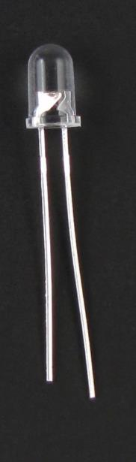
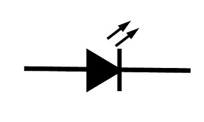
Light emitting diodes (LEDs)
Directional component: only allows current to flow one way
Shorter side is the negative one
i.e. where current flows to
Larger metal component
inside of case or case flat spot is cathode or
negative (-) lead
Shorter wire is cathode or
negative (-) lead
Negative ( - ) lead
Schematic Symbol
Notes:
Light Emitting Diodes (LEDs) are vital actuators for embedded and Internet of Things (IoT) devices. They provide a visual indication of the device's state and can also be used for debugging purposes. LEDs are directional components that allow current to flow in one direction only.
Typically, the cathode, where the current flows, is the shorter side of the LED. LEDs are an effective way to indicate the status of a device and provide feedback during the development and testing phase.
They are also commonly used in consumer electronics and lighting applications.

Slide 39
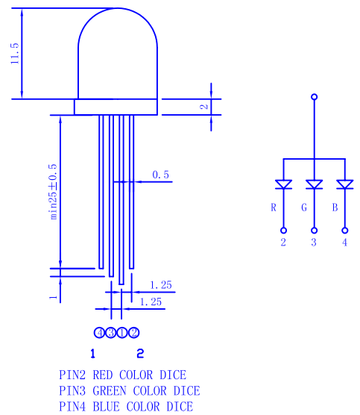
RGB LEDs
Three different colors of LED in a single large diffuser
Short leads are negative ends
One for each color
Long lead is common power
Common anode
Combinations of LEDs give other colors
Cyan, Yellow, Violet, White
https://cdn-shop.adafruit.com/datasheets/FLR-100WAS-RGB.pdf
Notes:
A unique variant of LEDs is the RGB (Red, Green, Blue) LED, which allows for the emission of three different colors. The short leads are the negative end, and each color has its own separate wire. By combining signals on multiple wires, a range of colors can be produced. RGB LEDs provide a versatile and efficient solution for adding color to embedded and IoT devices, as well as for lighting applications. By controlling the intensity of each color, a wide range of hues and shades can be generated, making RGB LEDs ideal for applications where dynamic color changes are desired.

Slide 40

Light sensing: LEDs?
LEDs can be used as photodiodes as well!
Apply reverse voltage. Read in leak current as voltage across a resistor using ADC

Slide 41
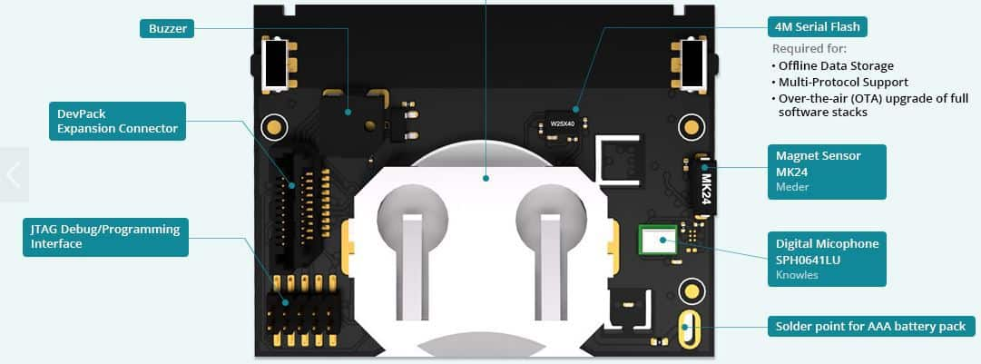
Actuators on Sensor Tags?

Slide 42
Sensors on SensorTag (CC2650)

Slide 43
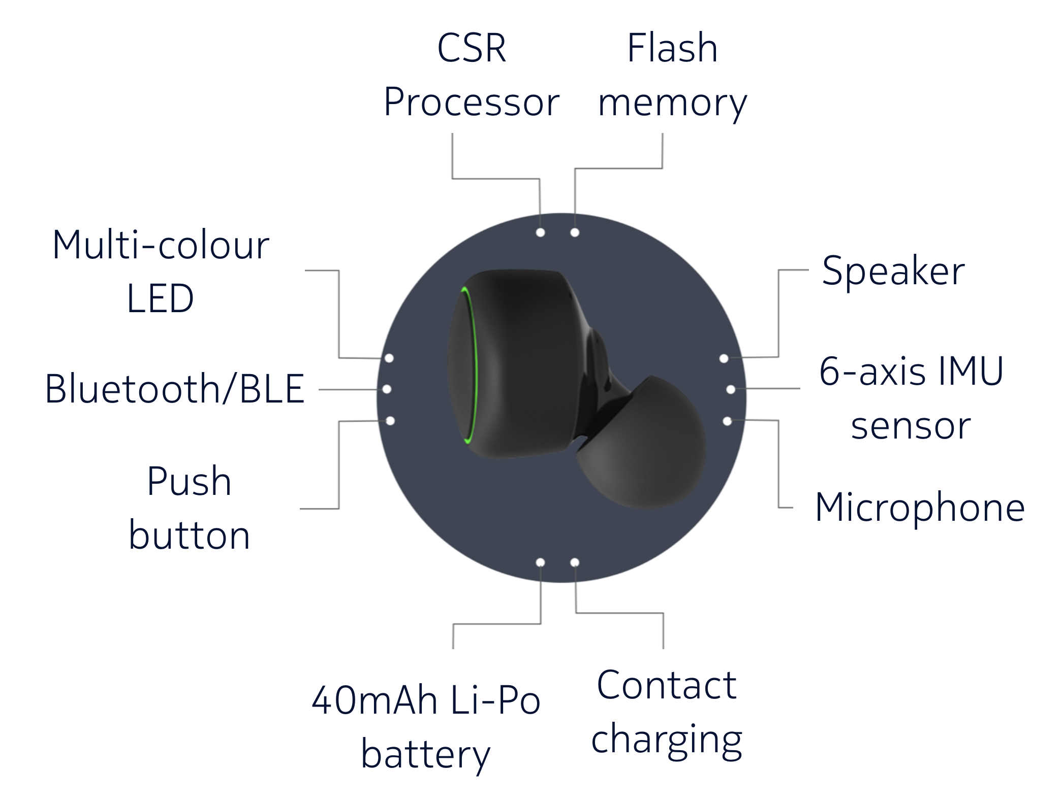
Other sensing platforms
Earables (Earphones as sensor)

Slide 44
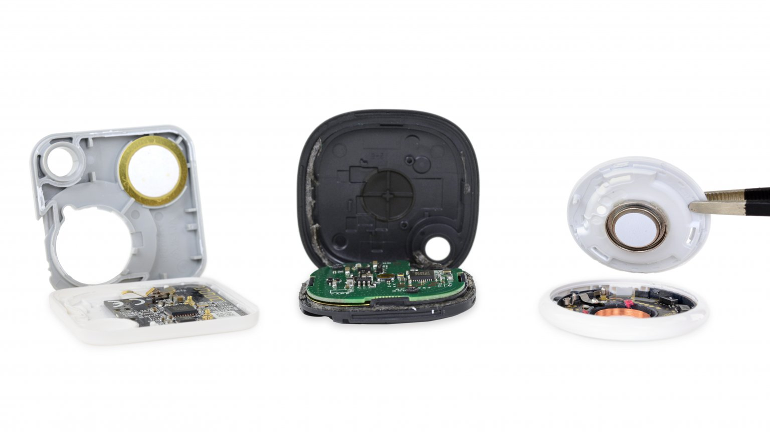
Let’s look at some commonly used IoT devices
Notes:
Backscatter communication actually help us overcome this limitation

Slide 45
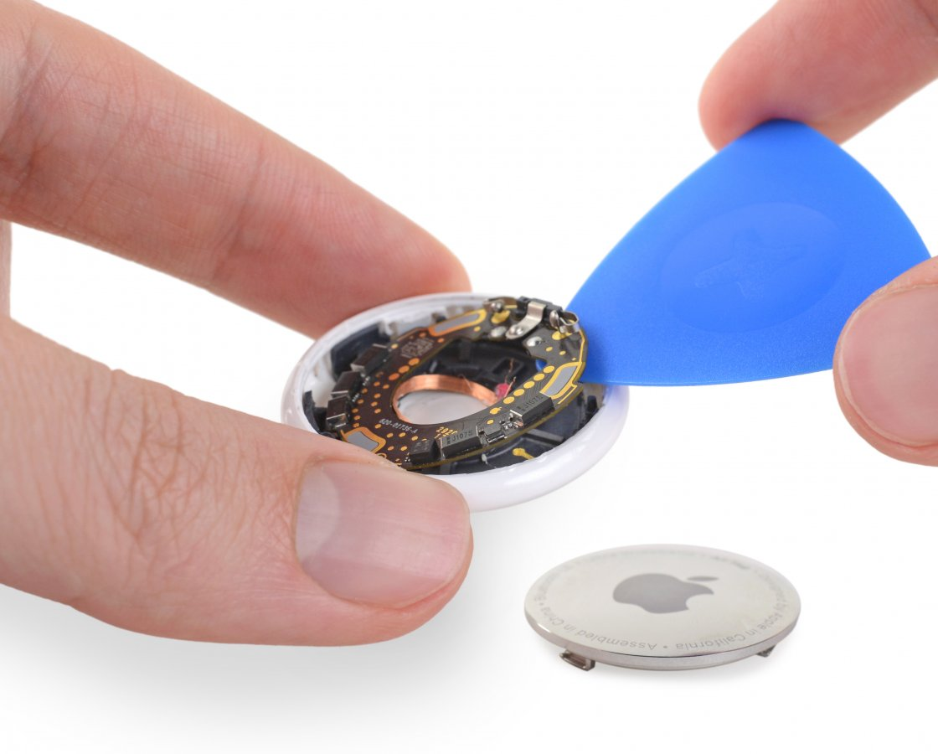
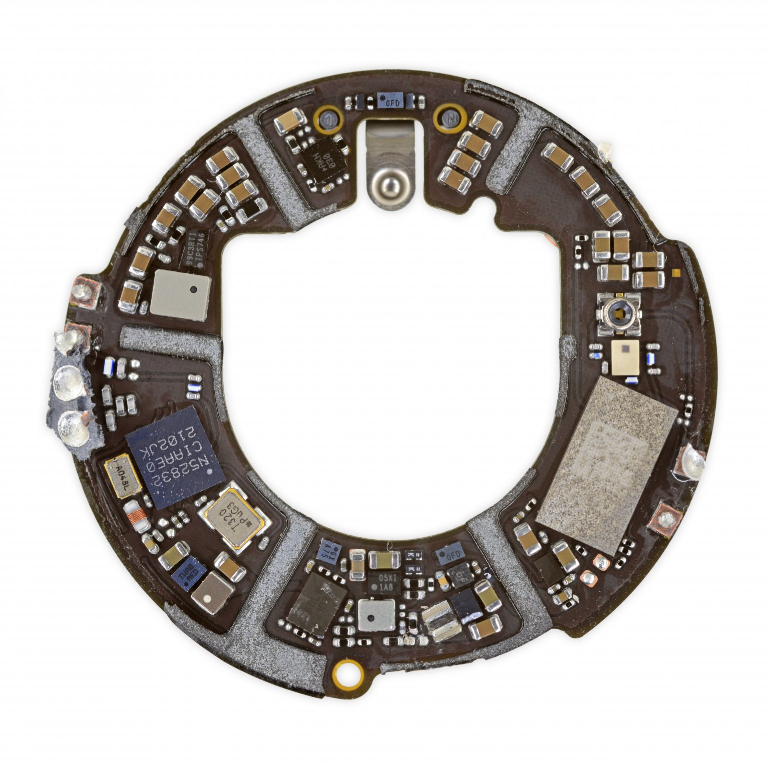
What’s inside Apple AirTag
Nordic Semiconductor nRF52832 Bluetooth low-energy SoC w/NFC controller
Notes:
Backscatter communication actually help us overcome this limitation

Slide 46
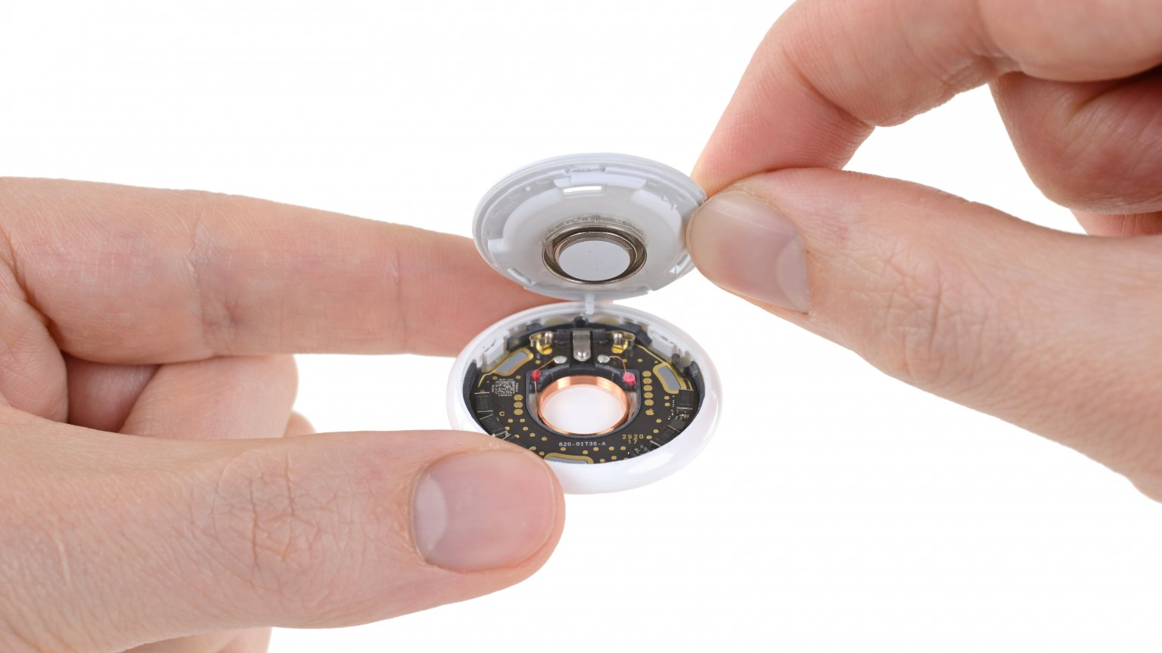
What’s inside Apple AirTag
Accelerometer: Bosch Sensortec BMA28x 3-axis accelerometer
SoC/Microcontroller: Nordic Semiconductor nRF52832 Bluetooth low-energy SoC w/NFC controller
Actuator: Speaker
And many other componets….
Notes:
Backscatter communication actually help us overcome this limitation

Slide 47

Let’s look at some commonly used IoT devices
Notes:
Backscatter communication actually help us overcome this limitation

Slide 48


Let’s look at some commonly used IoT devices
MediaTek MT3333 GPS SoC
Bosch Sensortec BHI160 Accelerometer/Gyroscope w/ Sensor Hub
STMicroelectronics LIS2DW12 MEMS 3-Axis Accelerometer
Fitbit FBT18SW ARM application processor
Notes:
Backscatter communication actually help us overcome this limitation

Slide 49

Let’s look at some commonly used IoT devices
Notes:
Backscatter communication actually help us overcome this limitation

Slide 50


Let’s look at some commonly used IoT devices
Actuator, very important: 85 dB horn for alarm
Freescale SCK60DN512VLL10 custom Kinetis K60 low-power 100 MHz MCU (Cortex based)
Silicon Labs EM357 Ember Zigbee SoC
Murata Type ZX 2.4 GHz Wi-Fi 802.11b/g/n module (with Broadcom BCM43362 chipset)
Notes:
Backscatter communication actually help us overcome this limitation

Slide 51

TraceTogether Token
Notes:
Backscatter communication actually help us overcome this limitation

Slide 52
Roadmap of the lecture today
Let us recall what was covered in the last lecture
Sensors and actuators
Teardown of common devices
Interfacing actuators through DAC and PWM
Interfacing peripherals through busses, UART
Introduction to SPI
Notes:
Here is the roadmap of the major topics that I am going to cover during the presentation. We have already covered the exponential growth of the internet of things; next, I will talk about the critical energy challenge that can severely hinder this massive growth and preventing us from realising this immense economic value enabled by the IoT.

Slide 53
Digital signals
Simplest form of I/O
Exist in two states:
High (a.k.a. Set, a.k.a. 1)
Low (a.k.a. Clear, a.k.a. 0)
Simpler to interact with
Constrained to two voltages
With quick transitions between the two
No math for voltage level
Either high or low

Slide 54
General Purpose Input/Output (GPIO)
Read/write from/to external pins on the microcontroller
Two possible values: high (1) or low (0)
Basic unit of operation for microcontrollers
Allows them to interact with buttons and LEDs
Every microcontroller has GPIO

Slide 55
DAC applications
What do you use an analog output for?
Audio output
But it needs to be high quality (resolution and speed)
Motors
But only with a controller that actually drives them with enough current
LED brightness

Slide 56

Digital-to-Analog Converters
Generates an analog voltage
DACs are conceptually the inverse of ADCs
Number of bits of resolution choose analog step size
Frequency determines step duration

Slide 57
High resolution versus high frequency
What role does each play in a DAC? Which is more important?
High resolution can accurately represent a voltage
High frequency can accurately represent a changing voltage
In practice:
Need high enough resolution, then as high of frequency as possible

Slide 58
DACs are not in all microcontrollers
Not rare, but not ubiquitous either
Every microcontroller has GPIO
Just about every microcontroller has an ADC
Some microcontrollers have DACs
Reasons
Use cases are uncommon (and might need very high quality)
Many devices can be controller digitally
Pulse-Width Modulation (PWM) can emulate usably analog signals

Slide 59

Pulse-Width Modulation
Much easier to control high or low than an analog output
Idea: modify how long a signal is high within some switching frequency, a.k.a duty cycle
On 50% of the time for half voltage
On 10% of the time for tenth voltage
Duty cycle, not frequency!

Slide 60

PWM to Analog Signal example

Slide 61
Every microcontroller can do PWM
Not every microcontroller has a PWM peripheral
But every microcontroller has timers and digital outputs
But all that is need is a GPIO and a Timer (or two)
Timer determines when to turn GPIO on and off
Often can be automated in hardware rather than use interrupt handler

Slide 62
PWM applications
Servos
Duty cycle chooses angle
Motor controllers
Duty cycle chooses current and therefore speed
LED brightness
And “breathing” effect
Audio
Can sound okay if frequency is high enough

Slide 63
Roadmap of the lecture today
Let us recall what was covered in the last lecture
Sensors and actuators
Teardown of common devices
Interfacing actuators through DAC and PWM
Interfacing peripherals through busses, UART
Introduction to SPI
Notes:
Here is the roadmap of the major topics that I am going to cover during the presentation. We have already covered the exponential growth of the internet of things; next, I will talk about the critical energy challenge that can severely hinder this massive growth and preventing us from realising this immense economic value enabled by the IoT.

Slide 64
Connecting peripherals: wired or wireless
Wired
Send digital signals across one or more wires
Advantages: Reliable, Low energy, Often simpler topology
Disadvantages: Physically limiting
Wireless
Send digital signals across another medium (usually RF)
Advantages: Physically flexible,
Disadvantages: Unreliable, High energy, Usually broadcast

Slide 65

Number of wires to carry signal
Serial interface
Single wire
Transmit data as a “series” of bits separated by time
Cheaper, but slower to transmit
Parallel interface
Multiple wires
Transmit data across multiple “parallel” wires simultaneously
More expensive, but faster to transmit
Transmitter
Transmitter

Slide 66
Speed of communication for busses
Inherently limited by the speed of light
Speed of electricity 50-99% of that
29 cm (11.4 in) = 1 nanosecond
Speed of communication is also limited by interference
Faster the signals, the harder they are to distinguish
More susceptible to interference (matters less for wired communication)
Limited by whether other device can keep up

Slide 67
Example communication speed for wired protocol
Internal to platform, low-energy communication
UART, 1-1000 kbps
I2C, 100-400 kbps
SPI, 1-100 Mbps
External (mostly serial) communication
USB, 1-10000 Mbps
Ethernet, 1-1000 Mbps
HDMI, 4-48 Gbps
Internal parallel communication (less applicable to IoT devices)
PCI, 8-32 Gbps
RAM, 12-25 Gbps
Note: Speeds are measured in bit per second

Slide 68
Controlling timing in wired communication
Synchronous communication
Clock signal sent along with data
Data is captured at edge of clock signal (rising or falling)
Advantage: send signals very fast
Disadvantage: extra pin and wire
Asynchronous communication
Agree upon timing in advance and read data at that rate
Advantage: no need for clock signal
Disadvantage: clock synchronization
Transmitter
Receiver
b0
b1
b2
b3
b4
b5
b6
b7
DATA
CLK
Transmitter
Receiver
b0
b0
b0
b0
b0
b0
D0
b1
D1
b2
D2
b3
D3
b4
D4
b5
D5
b6
D6
b7
D7
CLK

Slide 69

How to connect: point-to-point networks
How do we connect computers in a network?
This is a question of “network topology”
Simple option: just connect them directly
Problem: what if I find a third computer?

Slide 70
How to connect: bus networks
Connect everything to one wire in parallel
Scales well to many computers
Problem: which computer gets to transmit when?
Simultaneous transmissions conflict
Need a scheme for “arbitration”, deciding who transmits when

Slide 71
How to connect: ring networks
Connect everything with point-to-point connections
Connect the last computer back to the first computer
Also known as Daisy-Chain (without the last connection back to the start)
Problem: what if a computer stops sending?

Slide 72

How to connect: star networks
Connect to a hub with point-to-point connections
Hub connects all computers
Hub is a computer with one job: transfer communications between computers

Slide 73



Microcontrollers often adopt star networks

Slide 74
Universal Asynchronous Receiver Transmitter
Serial communication between two devices
Two wires: transmit and receive
Simple to implement and very common on microcontrollers
Tradeoff choices: Serial, Low speed, Asynchronous, Point-to-Point
Most frequently used to send text data between devices
Microcontroller printf() output
Radio AT commands to/from microcontroller

Slide 75

Data frame for UART protocol
Signal is high by default
Goes low to trigger Start
Send each data bit (high=1, low=0), plus optionally parity bit
Goes high to trigger Stop

Slide 76

UART example, transmitting 0x32 and 0x3C

Slide 77

Baud rate for UART communication
Baud rate is a measure of “symbols per second”
Typically 1 bit per symbol, but not always
UART is 1 bit per symbol, but 8 data bits per 10/11 symbols
Any baud rate is possible
But there are a handful of normal configurations
115200 and 9600 are common

Slide 78

UART sampling rate
How do we make asynchronous communication work?
Both sides must agree on the baud rate
Listen for start bit
Conceptually:
Only need to sample 9-10 more times at baud rate spacing
Short enough that clocks should diverge too much
Realistically:
Sample 8 or 16 times per bit
Determine boundaries between bits
Select most common value between boundaries

Slide 79

UART: chip-to-chip communication
Usually implemented as a two-wire interface
TXD: Transmits data
RXD: Receives data
Optionally two additional pins for flow control
No clock signal! Asynchronous
Note: TX connects to RX

Slide 80
Detecting errors with parity
Choose one configuration for all UART messages
Even parity: total number of “1” bits in data is even
Odd parity: total number of “1” bits in data is odd
Parity bit: set to 1 or 0 to guarantee the parity configuration
If message doesn’t match parity configuration at receiver, there was a bit error (single error detecting)
Example: Data = 10101011 (five “1” bits)
Odd parity: set parity bit to zero
Even parity: set parity bit to one

Slide 81
What are error conditions for UART?
Parity failure
Bit error when receiving data
Overrun
New data arrived and overwrote buffer in peripheral before it was read
Framing
Did not see Stop Bit when expected (should be guaranteed “1”)
Break condition
Signal is low for entire message (Zero data plus Framing Error)
Often used as a signal between devices

Slide 82

Flow control for databits
How do we ensure that the other device is ready for the message?
Add two pins for “hardware flow control”
Ready To Send (RTS) output, signals that you want to send data
Clear to Send (CTS) input, signals that other device is ready to receive
Software flow control is possible
Send special byte that means pause or resume transmissions

Slide 83

How to allow UART to communicate to computer?
FTDI makes the most common chip to do this (FT232)
Microbit uses a microcontroller to do this!
KL27Z connects to USB
Also connects to nRF52833 via UART and JTAG
ttyACM0 is a “virtual serial device” on top of USB, miniterm is a serial console

Slide 84
UART Pros and Cons
Pros
Only uses two wires
No clock signal is necessary
Can do error detection with parity bit
Cons
Data frame is limited to 8 bits (20% signaling overhead)
Doesn’t support multiple device interactions (point-to-point only)
Relatively slow to ensure proper reception

Slide 85

boards/microbit_v2/microbit_retarget.c
printf() eventually calls _write()with formatted data
Converts stdio calls into UART TX and RX
Library just sets DMA and starts Tx

Slide 86
Roadmap of the lecture today
Let us recall what was covered in the last lecture
Sensors and actuators
Teardown of common devices
Interfacing actuators through DAC and PWM
Interfacing peripherals through busses, UART
Introduction to SPI
Notes:
Here is the roadmap of the major topics that I am going to cover during the presentation. We have already covered the exponential growth of the internet of things; next, I will talk about the critical energy challenge that can severely hinder this massive growth and preventing us from realising this immense economic value enabled by the IoT.

Slide 87
Synchronous communication with a single device
Device 1
Microcontroller
Device 2
Data Out Clock
Data In Clock
Device 3

Slide 88
Want bi-directional communication, so three wires
Device 1
Microcontroller
Device 2
Data Out Data In Clock
Data In Data Out Clock
Device 3

Slide 89
Wire signals to all devices to form a bus
Device 1
Data In Data Out Clock
Microcontroller
Device 2
Data Out Data In Clock
Data In Data Out Clock
Device 3
Data In Data Out Clock

Slide 90
Communicating on a bus
How do you distinguish which device you are talking to?
Address for each device
GPIO pin for each device

Slide 91
Communicating on a bus
How do you distinguish which device you are talking to?
Address for each device
Devices must always listen and then discard messages that aren’t for them
Need to define packet format so it’s clear where the address is
Need a method for addressing devices
GPIO pin for each device
Signal which device is being communicated with
Only activates communication on transition of “select” line

Slide 92
Separate chip select line for each device
Device 1
Data In Data Out Clock
Chip Select
Microcontroller
Device 2
Data Out Data In Clock
(2) Chip Select
Chip Select
(3) Chip Select
Data In Data Out Clock
Chip Select
Device 3
Data In Data Out Clock
Chip Select

Slide 93




Serial Peripheral Interface (SPI)
Device 1
Serial, synchronous, bus communication protocol
Single controller with multiple peripherals
Within a circuit board
High-speed communication
Multiple Mbps
Serial Data In Serial Data Out Serial Clock
$$\overline{\text{Chip} \text{Select} }$$
Microcontroller
Device 2
Serial Data Out Serial Data In Serial Clock
$$\overline{\text{Chip} \text{Select} }$$
$$\overline{\text{Chip} \text{Select} }$$
$$\overline{\text{Chip} \text{Select} }$$
Serial Data In Serial Data Out Serial Clock
$$\overline{\text{Chip} \text{Select} }$$
Device 3
Serial Data In Serial Data Out Serial Clock
$$\overline{\text{Chip} \text{Select} }$$

Slide 94
Roadmap of the lecture today
Let us recall what was covered in the last lecture
Sensors and actuators
Teardown of common devices
Interfacing actuators through DAC and PWM
Interfacing peripherals through busses, UART
Introduction to SPI
Notes:
Here is the roadmap of the major topics that I am going to cover during the presentation. We have already covered the exponential growth of the internet of things; next, I will talk about the critical energy challenge that can severely hinder this massive growth and preventing us from realising this immense economic value enabled by the IoT.

Slide 95
Embedded Software Programming
Ambuj Varshney
ambujv@nus.edu.sg
Notes:
++ Thank you for inviting me to give this talk
++ In this talk, I will present a pathway that can enable us to make wireless embedded systems ubiquitous. I will describe my previous research efforts that tackle the critical challenges that limit the growth of wireless embedded systems. These are related to the growing energy asymmetry that exists between sensing, computation and communication blocks on these platforms.
++ Finally, I will conclude my talk by covering the research agenda that I would like to work on as a faculty member.

